Slide 1
Note to presenter
Thank you for participating in the When I’m 65 program and for working to make sure everyone has the information they need to plan for a secure and fulfilling retirement.
This slide set was developed as part of the When I’m 65 program and is designed to be used with the “Making Your Money Last in Retirement” booklet and the When I’m 65 documentary and complementary video as part of an investor education course or other educational event, curriculum or course of study.
The content is designed to educate adults ages 70+ who are fully retired or still working and looking to lock in sources of guaranteed retirement income and spend their savings safely. The target audience also includes individuals exploring ways to stay engaged in the workforce, to make the most of Medicare and to receive trustworthy financial advice as they age.
When I’m 65 offers a lot of great video that you can download and include with this presentation including the full documentary. Go to www.wi65.org/video and click on “Information for Age 70+.”
The When I’m 65 materials are all independent, unbiased, noncommercial and for educational use only. Facilitators/presenters are prohibited from selling financial or investing products or services as part of the When I’m 65 program.
Delete this slide before the presentation.

Slide 2
MAXIMIZING RETIREMENT INCOME
7 STEPS YOU CAN TAKE TODAY

Slide 3
The When I’m 65 program
How we live & thrive in retirement is changing dramatically
The When I’m 65 program is a national public television documentary and a multi-year community engagement program.
The When I’m 65 documentary explores:
          Multi-generational approaches to retirement
      Changing attitudes toward work, debt, housing, and financial fraud
      Financial choices Americans of all ages must make to plan for a financially secure future
The When I’m 65 community engagement program uses screenings of the documentary, engagement videos, booklets, in-person training, and other resources to stimulate discussions and online activity to help individuals and families prepare for a financially secure retirement.
www.wi65.org | facebook.com/WI65Project | twitter.com/WI65Project

Slide 4
When I’m 65 program partners
The When I’m 65 documentary and community engagement program is made possible by:
The Investor Protection Trust (IPT) is a nonprofit organization devoted to investor education. Since 1993, the Investor Protection Trust has worked with the states and at the national level to provide the independent, objective investor education needed by all Americans to make informed investment decisions.
www.investorprotection.org | facebook.com/InvestorProtectionTrust | twitter.com/IPT_Info
The Investor Protection Institute (IPI) is an independent nonprofit organization that advances investor protection by conducting and supporting unbiased research and groundbreaking education programs.
www.iInvest.org | facebook.com/InvestorProtectionInstitute | twitter.com/IPI_News
Detroit Public Television is a viewer-supported PBS member station located in Wixom, Michigan. Their vision is for a community in which people trust public media to help them discover new ideas, make informed decisions and enjoy enriched lives. The station is notably active in producing programs that showcase arts, culture, news and analysis; and educational outreach campaigns that use the power of media to provide knowledge and understanding.
www.dptv.org | facebook.com/detroitpublictv | twitter.com/detroitpublictv

Slide 5
Introduction
Whether you’re already retired or still working, you need to be able to rely on a sustainable plan for your savings.
The goal is to achieve the retirement lifestyle you want while ensuring your money lasts 20 or even 30 years.
Now’s the time to lock in sources of guaranteed income, as well as preserving and protecting the savings you have.
Every move you make today will help you take charge of your financial security.

Slide 6

7 steps to take today
Identify sources of income.
Understand the rules for required minimum distributions (RMDs).
Stay engaged in the workplace.
Spend your savings safely.
Manage Medicare wisely.
Get trustworthy advice as you age.
Consider your location.
Let’s take a closer look at the seven steps.

Slide 7
Step 1: Identify sources of income
Beyond Social Security and pension income, identify as many income sources as possible. For example:
  Retirements savings, such as 401(k)s or IRAs.
  Nonretirement savings, such as money market accounts, mutual funds or individual stocks and bonds.
  Reverse mortgages, which let you borrow against the equity in your home.
  Annuities, which are self-funded and offer a guaranteed income stream.
  An encore career or entrepreneurial pursuit that continues to bring in income.
  Adding roommates to offset costs of home ownership while aging in place.

Slide 8
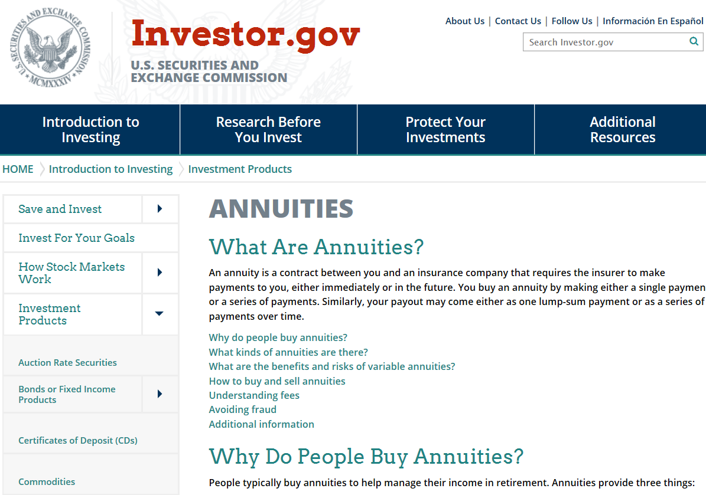
ACTION STEPS
Talk with an HECM counselor. You must meet with a government-approved professional before applying for a home equity conversion mortgage (HECM).
Find a counselor by using the FHA’s search tool, available at:
https://entp.hud.gov/idapp/html/hecm_agency_look.cfm
Learn more about annuity pros and cons with this resource, “What Are Annuities,” available at:
www.investor.gov/introduction-investing/basics/investment-products/annuities

Slide 9
Step 2: Understand the rules for RMDs
THE BASICS
RMDs are the minimum amount of money you’re required by IRS rules to take out of your tax-deferred retirement plans.
These accounts include traditional IRA, 401(k), 403(b), and 457(b) plans.
Withdrawals are required every year once you turn age 70½.
If you don’t take your full RMD, you’ll be subject to a steep tax penalty of 50% of the amount you failed to withdraw.

Slide 10
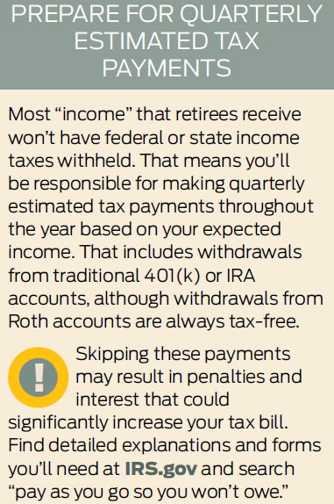
Understand the rules for RMDs
THE DATES
You generally must take your first RMD by April 1 of the year after you turn 70½.
In subsequent years, you must take RMDs by December 31.
If you push your first RMD to the year after you turn 70½, you’ll have to take (and pay tax on) two RMDs in one year.
Example: Say you turned 70½ in 2018 but put off taking the RMD until March 2019. In 2019, you’ll also have to withdraw the RMD for that year, so you’ll face a double tax burden.

Slide 11
2 exceptions
Usually, you don’t have to take RMDs from your current employer’s 401(k) account until you leave that job. If you own more than 5% of the company, however, you must start RMDs at age 70½ even if you’re still on the job.
While you do have to take RMDs from Roth 401(k)s, you’re not required to take them from Roth IRAs. In both cases, the withdrawals are tax-free.
Question:
Do separate RMDs apply for married couples filing jointly?
Answer:
You and your spouse must take RMDs separately from your own accounts even if you file a joint tax return.
Pulling the RMD from only one spouse’s account will trigger IRS penalties.

Slide 12
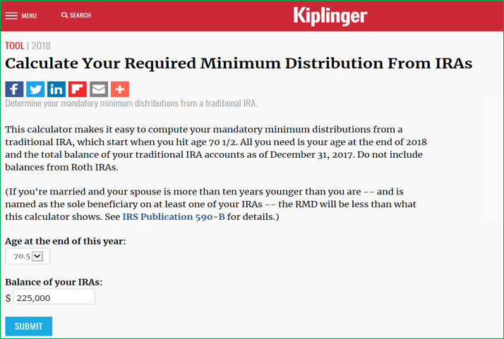
ACTION STEP
A tax pro can help you calculate your RMDs, but you can get a quick estimate using these tools:
www.irs.gov/retirement-plans/plan-participant-employee/required-minimum-distribution-worksheets
www.kiplinger.com/tool/retirement/T032-S000-minimum-ira-distribution-calculator-what-is-my-min/index.php
https://www.investor.gov/additional-resources/free-financial-planning-tools/401k-ira-required-minimum-distribution-calculator

Slide 13
Step 3: Stay engaged in the workplace
Continuing to work in some capacity can be a key strategy for making your money last.
Nearly nine in 10 people expect working to provide extra income in retirement.
Pre-retirees also say they’ll choose to work simply to stay active and involved.
Let’s explore some of the many ways you can discover a work opportunity that meets your needs.

Slide 14

Stay engaged in the workplace
Target your search to organizations that cater to retirees. Three resources:
The AARP Job Board at jobs.aarp.org matches your interests and skills with employers committed to an age-diverse workforce.
YourEncore.com partners with top life sciences and consumer companies to recruit retirees with scientific or technical backgrounds.
Encore.org, through its Encore Fellowships, matches experienced professionals who are 50+ with social purpose organizations for paid transitional positions.

Slide 15
Stay engaged in the workplace
CONSIDER THE GIG APPROACH
Anyone can connect to the gig economy, thanks to online platforms that link skilled providers with temporary paid work.
2 examples:
Speak a foreign language or play a musical instrument? You can find tutoring opportunities at TakeLessons.com.
Find ratings and reviews of more than 250 gig opportunities, their earning potential, and fees at SideHusl.com.

Slide 16
Stay engaged in the workplace
EXPLORE ENTREPRENEURSHIP
Older adults are a growing segment of the U.S. entrepreneurial population.
Self-employment on your own terms provides greater flexibility.
2 examples:
  SBA.gov offers a free online course for “encore entrepreneurs.” Search for “An Introduction to Starting Your Own Business.”
  SCORE.org offers free business mentoring and startup education across 62 industries in 320 US locations.

Slide 17
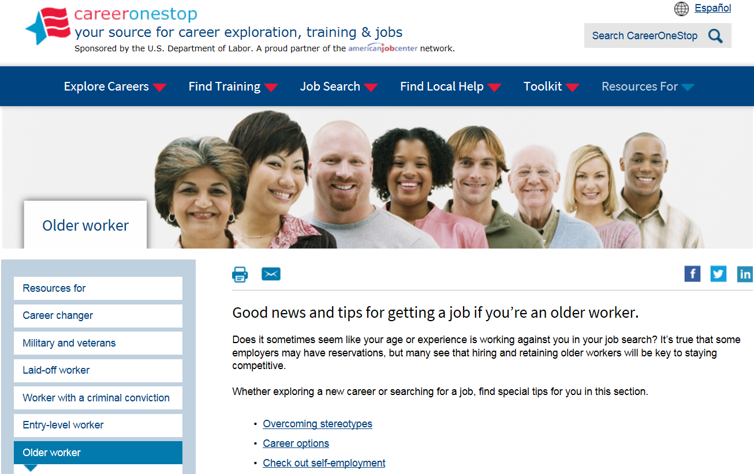
ACTION STEP
Find workforce tips, job advice, and employment services specifically geared to older adults by visiting:
The US Department of Labor’s age-specific resources portal www.careeronestop.org/ResourcesFor/OlderWorker/older-worker.aspx

Slide 18
Step 4: Spend your savings safely
CALCULATE A SAFE SPEND-DOWN PLAN
One rule of thumb that many financial experts recommend is the “4% rule.” This means:
Withdrawing 4% of total savings (from both retirement and nonretirement accounts) during the first year.
Each year thereafter, increase that 4% slightly to account for inflation.
Adjust the percentage every year, up or down, depending on the depth of your income sources and how well your investments perform.
Key to the success of this recommendation:
Don’t spend more than your money earns.
Example: If your portfolio earns an average 3% return per year, withdrawing 4% may deplete it too quickly.

Slide 19

Spend your savings safely
USE A BUCKET STRATEGY FOR THE LONG HAUL
This strategy divides your savings into three “buckets.”
Each is based on a three-stage time horizon.
Let’s look at what each bucket holds, and how they work together.

Slide 20
Spend your savings safely
BUCKET 1 – NOW
Holds the cash you’ll need for living expenses over the next year or two.
Prioritizes safety over earnings, so this money is stashed in an FDIC-insured bank or money market account (as opposed to a money market fund, which is an investment).
Allows easy access to the money whenever you need it.
As money flows in from your income sources, deposit it here.

Slide 21
Spend your savings safely
BUCKET 2 – SOON
Generates reliable income from relatively conservative sources such as:
  Bonds
  Laddered bank CDs
  High-performing money market funds
  Blue-chip preferred stocks (if you’re willing to take a little risk).
Contains money you expect to need in three to five years.
Note: If you own an immediate annuity with guaranteed income, you may not need to hold as much money in this bucket.

Slide 22
Spend your savings safely
BUCKET 3 – LATER
Collects money you don’t expect to need for at least five years.
Focus is on growth, so this bucket includes long-term investments such as stocks and real estate.
More financial risk is acceptable here, because there’s time for recovery should any holdings lose value.

Slide 23
Spend your savings safely
How the buckets work together
As you spend down your “Now” bucket …
You periodically replenish it from your “Soon” bucket …
And refill that with funds from your “Later” bucket.
Key take-away: The bucket strategy’s strength is built-in diversification.
By focusing on specific asset classes in each bucket, you won’t be over-invested in any one type. That lowers your risk.
How to implement the system on your own:
Explore low-fee bond and fixed-income mutual funds or ETFs for your “Soon” bucket.
Stick with broad market index funds for your “Later” bucket.
Or, consider working with a trusted financial adviser to help plan the best approach.

Slide 24
Spend your savings safely
PRESERVE SAVINGS WITH TAX-SMART WITHDRAWALS
As you start taking money out of retirement accounts, income taxes come into play.
To minimize that inevitable tax bite, you’ll want to time withdrawals strategically.
Let’s review a three-step plan to accomplish this goal.
$

Slide 25
Spend your savings safely
TAKE STRATEGIC WITHDRAWALS, IN 3 STEPS
First, take all RMDs from retirement plans to avoid the steep IRS penalty. These include:
                Traditional IRAs, 401(k) plans, 403(b) plans, and 457(b) plans.
    Note: For traditional IRAs, you can take the whole RMD from a single account – but it must be based on the total balance of all your qualified accounts. What if you have several 401(k)s? Calculate and withdraw the RMDs separately from each account.

Slide 26
Spend your savings safely
Second, pull money from taxable accounts.
Since you pay taxes on earnings in regular savings and investment accounts every year anyway, it makes sense to withdraw from them next.
The reason? You won’t be adding extra taxable income and increasing your tax bill.
Third, take any withdrawals (beyond RMDs) from your tax-deferred and tax-free accounts (such as Roth IRAs) last.
Why? This allows your money the most uninterrupted time to keep growing.
Best bet: Draw down these funds only when the combination of RMDs and taxable account withdrawals falls short of your monthly expenses.

Slide 27
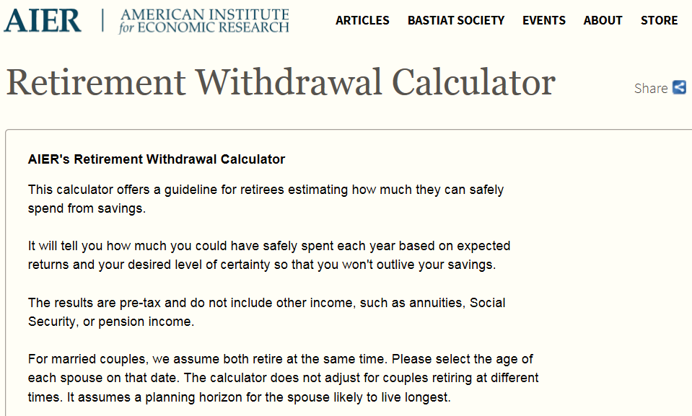
ACTION STEPS
Read “How to Implement the Bucket System” at:
https://www.kiplinger.com/article/retirement/T037-C000-S002-how-to-implement-the-bucket-system-in-retirement.html
Check out the impact of different spend-down rates with a tool from the American Institute for Economic Research website at:
https://www.aier.org/retirement-withdrawal-calculator
Get specific guidance about retirement and taxes at:
https://www.irs.gov/individuals/seniors-retirees

Slide 28

Step 5: Manage Medicare wisely
Even if you’re already enrolled in Medicare, it’s important not to overlook the annual opportunity to review coverage and change plans.
And, if you or a spouse continued working after age 65 and still have health insurance through an employer, you may have delayed your Medicare signup.
In this section, we’ll look at the details of both situations.

Slide 29
Manage Medicare wisely
UNDERSTAND THE FUNDAMENTALS
Basic Medicare coverage includes:
Part A – covers hospitalization and is premium-free for most people.
Part B – covers doctor visits and outpatient services, with a monthly premium.
You’re eligible at age 65:
If you’re already receiving Social Security benefits, you’re enrolled in Part A automatically.
If you haven’t claimed Social Security benefits, Medicare enrollment is not automatic.
TAKE NOTE
If neither you nor your spouse has employer health coverage, you should sign up for both
Part A and Part B.
Go to SSA.gov/Medicare to enroll three months before or after the month you turn 65—even if you aren’t signing up for Social Security.

Slide 30
Manage Medicare wisely
UNDERSTAND THE FUNDAMENTALS
Are you or your spouse still working and have employer coverage?
You may be able to delay signing up for Part B until your employer coverage ends.
But beware: You must enroll within eight months after this coverage ceases or face a lifetime penalty of higher premiums for Part B coverage.
Ability to delay also depends on employer size. If your employer has fewer than 20 employees, then Medicare typically becomes primary coverage at 65—and you generally need to enroll then to avoid any coverage gaps.
This penalty amounts to 10% of the current Part B premium for every year you should have been enrolled in Part B but were not!

Slide 31
Manage Medicare wisely
YOUR RIGHT TO CHANGE COVERAGE
Every year, you have the opportunity to change, add or drop coverage for Part D or Medicare Advantage plans during open enrollment season.
It’s wise to check out your options each year, even if you’ve been happy with your plan.
For example:
                Your prescription drugs or health needs may have changed.
        Plans may have changed premiums or coverage.
        New plans may have entered or left the business in your area.

Slide 32
Manage Medicare wisely
PLUG COVERAGE GAPS
Because Medicare has deductibles and copays and doesn’t cover prescriptions, most people purchase additional coverage.
Choices include:
  Medigap, a Medicare supplement policy, which covers deductibles and co-pays.
  Part D policy, which covers prescription drugs.
  Medicare Advantage plan (Part C), which provides both medical and prescription drug coverage from a private insurer.
  Which option may be right for you? Let’s do a quick comparison.

Slide 33
Manage Medicare wisely
Medigap
Usually higher premiums.
Fewer out-of-pocket costs.
Can use any doctor, hospital or other provider that accepts Medicare.
MEDICARE ADVANTAGE
Run by private insurers, similar to employer HMO or PPO coverage.
Some charge nothing beyond Medicare Part B premium.
More out-of-pocket costs.
Limited network of doctors and hospitals.

Slide 34
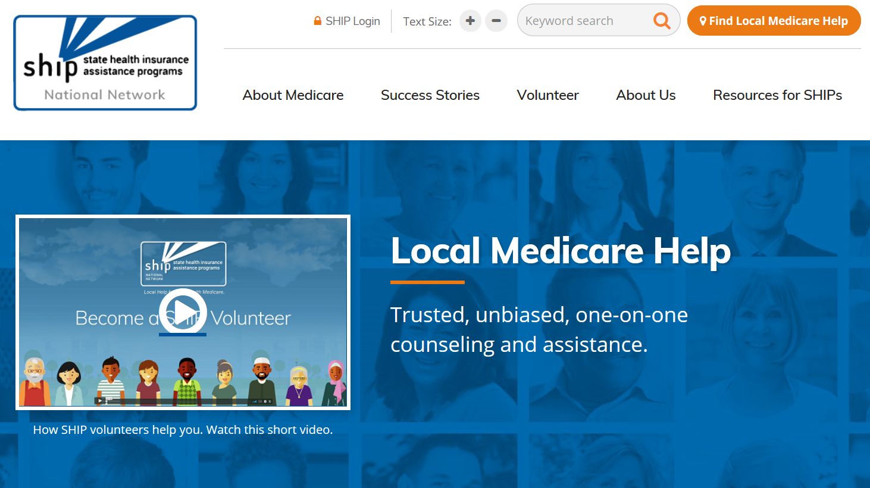
ACTION STEP
Navigate Medicare choices by checking out these sites:
The local State Health Insurance Assistance Program in your area at:
www.shiptacenter.org/
Free tools available from the nonprofit Medicare Rights Center at:
www.medicarerights.org/
Cost and coverage comparisons for all the Medicare Advantage and Part D plans in your area at:
www.medicare.gov/find-a-plan/questions/home.aspx

Slide 35
Step 6: Get trustworthy advice as you age
A more holistic approach to financial management may be needed at this stage of life.
A trusted team of advisers—such as a financial adviser or counselor, an attorney, and a tax preparer—can help you make the increasingly complex decisions that retirement often brings.
Examples: money management, asset protection, fraud protection, estate planning, and healthcare planning.

Slide 36
Get trustworthy advice as you age
CHOOSE A FIDUCIARY
Legally and ethically bound to put your interests first and avoid any conflict of interest.
Work for fee-based compensation, meaning their pay is the same no matter which investments you make.
Ask directly whether an adviser is a fiduciary.
  Reason: Certain professionals (like attorneys, CPAs, and doctors) always have a fiduciary obligation to clients. In other professions (like insurance and financial services), the lines aren’t as clear. State laws also sometimes come into play.

Slide 37
Get trustworthy advice as you age
PROTECT YOUR LEGACY
Talk with family members about plans to preserve, protect, and maintain your estate.
It’s a crucial step to make sure your wishes are carried out as you envision.
Keep your adult children informed. Let’s look at the types of information you should plan to share.

Slide 38
Get trustworthy advice as you age
SHARE
Copies of important legal documents, such as a durable power of attorney for finances, a healthcare directive, and your most-recent will.
              Names and contact information for all professionals on your advisory team.
              Access to your Social Security number, driver’s license number, Medicare ID number, bank and brokerage accounts, passwords, etc.
DISCUSS
Preferences about long-term care, if needed.
Where and how you would like to live if you can no longer live independently.
A list of current doctors and medications.
Your wishes for final arrangements.
Updates as circumstances change, or at least every three to five years.

Slide 39

ACTION STEPS
Find a trusted adviser
Check out descriptions for common adviser credentials on the Financial Management Association website at:
www.fma.org/finance-certifications
Verify a specific adviser
Your State Securities Regulator can confirm an adviser’s licensing and education. Find your state regulator on the North American Securities Administrators Association website at:
www.nasaa.org

Slide 40

Step 7: Consider your location
Where you live can have a big impact on how long your nest egg may last. If you’re thinking about relocating, weigh factors like these:
      State and local taxes.
      Cost of living.
      Availability of senior housing and co-housing.
      Healthcare and wellness facilities.
      Transportation options.
      Community engagement and public amenities.
      Crime rates.

Slide 41

ACTION STEP
Evaluate key livability factors with tools like these:
BestPlaces City Compare www.bestplaces.net/compare-cities/
AARP Livability Index https://livabilityindex.aarp.org/
AARP Network of Age-Friendly States and Communities www.aarp.org/livable-communities/network-age-friendly-communities/info-2014/member-list.html

Slide 42
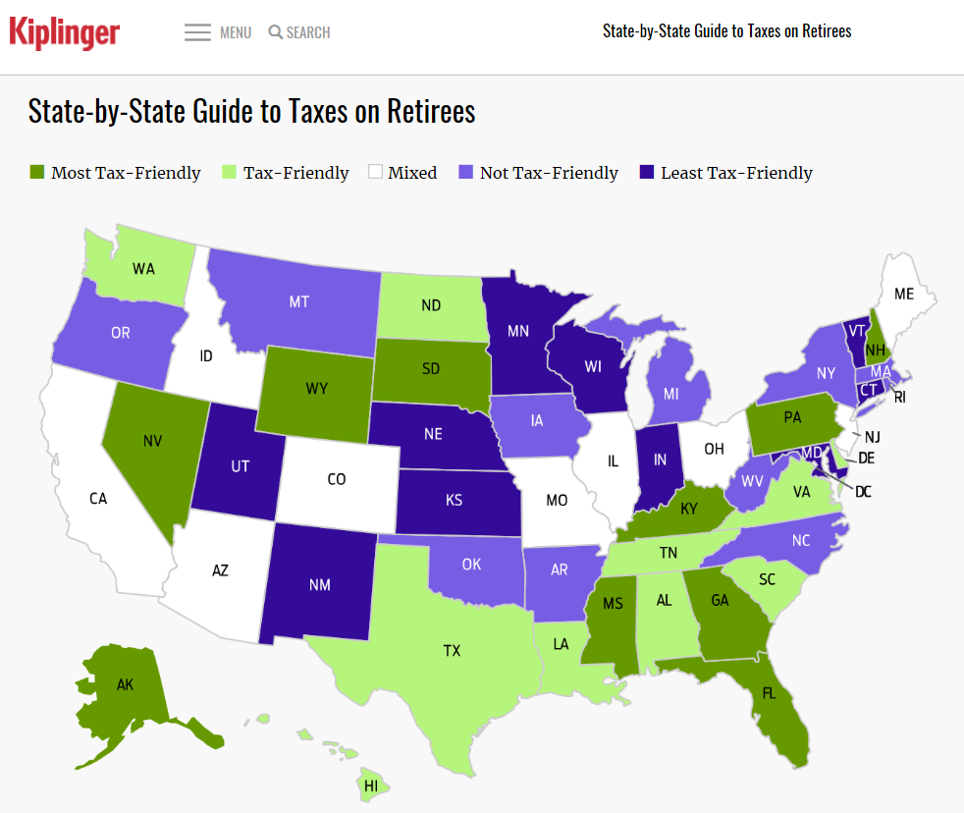
ACTION STEP
Then, check affordability with these tools:
Bankrate’s Cost of Living Calculator www.bankrate.com/calculators/savings/moving-cost-of-living-calculator.aspx
Kiplinger’s State-by-State Guide to Taxes on Retirees https://www.kiplinger.com/tool/retirement/T055-S001-state-by-state-guide-to-taxes-on-retirees/index.php?rid=PROD-LINKS

Slide 43

Quiz: Test your retirement know-how
Now that you’ve reviewed the many options for continuing to preserve savings and bolster income, you’re ready to focus on the strategies that make the most sense for your situation.
Let’s put your retirement planning skills to the test with these six questions!

Slide 44
Quiz: Test your retirement know-how
QUESTION # 1
You’re busy enjoying retirement and you just plain forgot to take your RMD. You know that these withdrawals from your tax-deferred retirement plans are required once you turn age 70½, but IRS rules allow you to skip a year if you either neglected to take it or completely miscalculated the amount.
True or false?
True
False

Slide 45
Quiz: Test your retirement know-how
THE ANSWER?
Unfortunately, that’s false. You’re required to take RMDs from retirement plans like a traditional IRA, 401(k), 403(b) and 457(b) every year once you reach the age threshold.
What’s more, if you don’t take your full RMD, there are hefty consequences: When an RMD is not correctly taken, any shortfall is subject to a 50% penalty.

Slide 46
Quiz: Test your retirement know-how
QUESTION # 2
Now that you’ve faithfully socked away as much as possible in retirement accounts and chosen investments carefully, you need to hatch a smart plan to figure out how much of your nest egg you can safely tap each year.
Which of these recommendations may enable you to hit that “sweet spot?”
A. The bucket strategy
B. The 4% rule
C. The time-segmentation plan
D. All of the above

Slide 47
Quiz: Test your retirement know-how
THE ANSWER?
D. All of the above. Calculating a safe spend-down rate could conceivably use all of these rules of thumb.
Many financial experts recommend the 4% rule, in which you withdraw 4% of total savings each year, increasing it slightly to account for inflation in subsequent years and adjusting it based on portfolio performance.
For the long run, experts also advise considering the bucket strategy – which is essentially a time-segmentation plan that divvies up your savings into three buckets for money you’ll use now, soon or later.

Slide 48
Quiz: Test your retirement know-how
QUESTION # 3
To minimize the tax bite, which accounts should you consider tapping first when withdrawing from your portfolio?
Rank your choices by order of priority.
Taxable accounts
Tax-advantaged accounts
Accounts subject to Required Minimum Distributions (RMDs)

Slide 49
Quiz: Test your retirement know-how
THE ANSWER?
To lessen the tax impact, consider withdrawing money from your retirement portfolio strategically in this three-part sequence:
Take your RMDs from tax-deferred accounts like IRAs and 401(k)s to avoid the steep IRS penalty.
Pull money from taxable accounts next. Since you pay taxes on the earnings in savings and investment accounts every year anyway, it makes sense to withdraw from them second. That way, you won’t be accumulating additional taxable income.
Tax-advantaged accounts are last. Tap these funds only when the combination of RMDs and taxable account withdrawals isn’t enough to cover your monthly expenses.

Slide 50
Quiz: Test your retirement know-how
QUESTION # 4
True or false?
You’re already enrolled in Medicare, and you think your current coverage works pretty well for your needs. Even so, it’s wise to revisit your plan options every year during open enrollment season.
True
False

Slide 51
Quiz: Test your retirement know-how
THE ANSWER?
Yes, it’s true. Change happens, so even if you’re satisfied with your plan, it can make sense to review the options. Perhaps your prescription needs are different or providers may have changed their premiums and coverage.
You have an annual right to change, add or drop coverage for Medicare Part D or Medicare Advantage plans during open enrollment periods, which are either October 15 to December 7, or January 1 to March 31 – depending on the type of plan you currently have.

Slide 52
Quiz: Test your retirement know-how
QUESTION # 5
At this stage of life, it’s crucial to talk with family about your plans to preserve, protect, and maintain your estate.
Which of these should you provide to a fiduciary financial professional or trusted family member?
Names and contact information for your financial adviser, attorney, tax preparer, and other key professionals you work with.
Bank and brokerage accounts information, Social Security number, Medicare ID number, and passwords.
Copies of your most recent power of attorney, healthcare directive, and will.

Slide 53
Quiz: Test your retirement know-how
THE ANSWER?
Did you check all the boxes? That’s correct, you should keep a key adviser or trusted adult children informed about all of these issues and documents.
On top of that, family conversations around important topics such as retirement preparedness, eldercare, and estate planning can protect your legacy and ensure that your wishes are heard and will be carried out.
Lastly, don’t forget to update this information as circumstances change.

Slide 54
Quiz: Test your retirement know-how
QUESTION # 6
Jot down two reasons why where you live in retirement could impact how long your nest egg may last.
Reason #1:
Reason #2:

Slide 55
Quiz: Test your retirement know-how
THE ANSWER?
Reason #1: Cost of living.
Estimating the affordability of different locations by housing, food, health and lifestyle expenses can clarify money considerations of a potential move. For example, say you and your spouse live in Boston but are thinking about relocating to Vero Beach, Florida. Your current combined income is $72,000, but you’d need only $49,600 to maintain your current standard of living in the Sunshine State. That’s because the cost of living is 31% lower in Vero Beach than in Boston.
Reason #2: Taxes.
Tax rates for retirement income, property, and purchases among states can vary widely. Moving from a state with high income taxes to one with low or no income taxes, for example, can literally save you thousands of dollars each year.

Slide 56

Contact information
Presenter’s contact information

