Slide 1
Note to presenter
Thank you for participating in the When I’m 65 program and for working to make sure everyone has the information they need to plan for a secure and fulfilling retirement.
This slide set was developed as part of the When I’m 65 program and is designed to be used with the “Ramp Up Savings for Your Retirement” booklet and the When I’m 65 documentary and complementary video as part of an investor education course or other educational event, curriculum or course of study.
The content is designed to educate adults ages 40–55 at the midpoint of their career who are looking to accelerate their retirement savings, maximize earnings or obtain professional advice while in their prime earning years.
When I’m 65 offers a lot of great video that you can download and include with this presentation, including the full documentary. Go to www.wi65.org/video and click on “Information for Gen X.”
The When I’m 65 materials are all independent, unbiased, noncommercial and for educational use only. Facilitators/presenters are prohibited from selling financial or investing products or services as part of the When I’m 65 program.
Delete this slide before the presentation.

Slide 2
BOOSTING YOUR FUTURE PAYCHECK
5 STEPS YOU CAN TAKE TODAY

Slide 3
The When I’m 65 program
How we live & thrive in retirement is changing dramatically
The When I’m 65 program is a national public television documentary and a multi-year community engagement program.
The When I’m 65 documentary explores:
          Multi-generational approaches to retirement
      Changing attitudes toward work, debt, housing, and financial fraud
      Financial choices Americans of all ages must make to plan for a financially secure future
The When I’m 65 community engagement program uses screenings of the documentary, engagement videos, booklets, in-person training, and other resources to stimulate discussions and online activity to help individuals and families prepare for a financially secure retirement.
www.wi65.org | facebook.com/WI65Project | twitter.com/WI65Project

Slide 4
When I’m 65 program partners
The When I’m 65 documentary and community engagement program is made possible by:
The Investor Protection Trust (IPT) is a nonprofit organization devoted to investor education. Since 1993, the Investor Protection Trust has worked with the states and at the national level to provide the independent, objective investor education needed by all Americans to make informed investment decisions.
www.investorprotection.org | facebook.com/InvestorProtectionTrust | twitter.com/IPT_Info
The Investor Protection Institute (IPI) is an independent nonprofit organization that advances investor protection by conducting and supporting unbiased research and groundbreaking education programs.
www.iInvest.org | facebook.com/InvestorProtectionInstitute | twitter.com/IPI-News
Detroit Public Television is a viewer-supported PBS member station located in Wixom, Michigan. Their vision is for a community in which people trust public media to help them discover new ideas, make informed decisions and enjoy enriched lives. The station is notably active in producing programs that showcase arts, culture, news and analysis; and educational outreach campaigns that use the power of media to provide knowledge and understanding. www.dptv.org | facebook.com/detroitpublictv | twitter.com/detroitpublictv

Slide 5
Introduction
At the midpoint of your career, you’re in a strong position to rev up retirement planning.
Make sure you’re on track to reach your ideal retirement by assessing progress so far.
Then, assess whether you need to speed up savings, maximize earnings, or seek some professional advice.
It’s time to keep your goal in sight, so you’re ready to retire when you want – and on your terms.

Slide 6

5 steps to take today
Boost savings to supercharge asset growth.
Reassess investments based on your timeline and risk tolerance.
Get dependable financial advice to minimize risk and fortify assets.
Plan to maximize Social Security.
Determine when you want to retire.
Let’s take a closer look at the five steps.

Slide 7
Step 1: Boost savings to supercharge asset growth
Take advantage of special, tax-advantaged “catch up” contributions to retirement accounts when you turn 50.
These annual contributions can turbocharge savings, helping you make up for lost time.
The IRS decides whether to change annual limits on contributions and benefits; find the current year’s limits at: www.irs.gov/retirement-plans/plan-participant-employee/retirement-topics-contributions
IRS facts on catch-up contributions:
In employer plans, like 401(k) and 403(b) plans, you can contribute an extra $6,000, bringing the maximum total annual contribution to $24,500 for 2018.
For Roth and traditional IRAs, you can contribute an extra $1,000, for a total annual contribution of $6,500 for 2018.

Slide 8
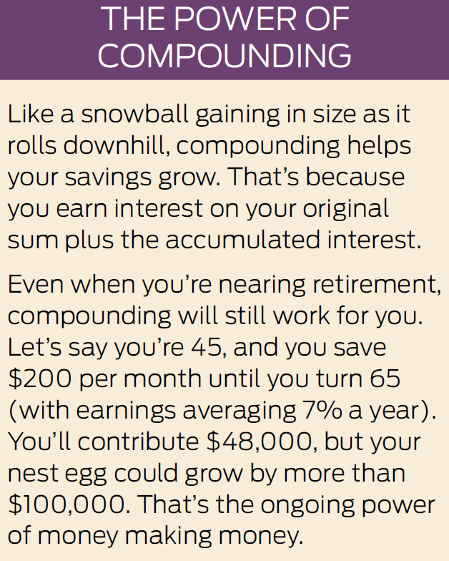
A crucial rule: Don’t sabotage savings
Avoid taking early withdrawals or loans from retirement accounts.
You’ll lose the momentum of compounding on that money.
And you may also have to pay 10% early-withdrawal penalties, plus taxes.

Slide 9
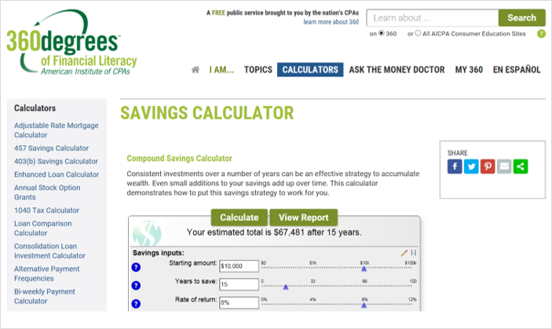
ACTION STEP
Experiment with these calculators to assess your savings growth and see how much you may need to adjust to reach your goals.
www.360financialliteracy.org/Calculators/Savings-Calculator
www.investor.gov/additional-resources/free-financial-planning-tools/compound-interest-calculator
www.bankrate.com/calculators/savings/saving-goals-calculator.aspx

Slide 10
Step 2: Reassess your investments
ADJUST THE MIX TO MATCH YOUR TIMELINE
Review investments in your retirement accounts based on changing circumstances and your personal timeline.
Aim to customize your asset mix, maximizing and protecting your nest egg as you get closer to retirement.
Common rule of thumb: Set a percentage allocation for stocks by subtracting your age from 120.
Examples: At age 40, invest 80% in stocks and 20% in bonds and cash. At age 50, invest 70% in stocks and 30% in bonds and cash.

Slide 11
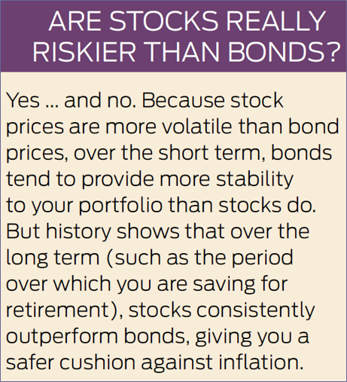
Review your mix regularly
Other circumstances also may prompt the need to rebalance holdings.
Consider changes in your life situation, such as:
  Getting divorced or remarried.
  Sending a child to college.
Continue to revisit the mix of retirement holdings at least once a year.

Slide 12
Reassess your investments
Consider target date funds
Mutual funds based on the approximate year you plan to retire.
Automatically adjust holdings toward more conservative investments as target date approaches.
Designed to be the only investment in your retirement portfolio; holding other funds defeats their purpose.
Each fund takes its own “glide path” and timetable toward conservative holdings.
Know whether it’s a “to” fund or a “through” fund.
“To” funds aim to reach their most conservative portfolio mix on the target date.
“Through” funds won’t hit that final portfolio until after the target date, taking fund holders through retirement.

Slide 13
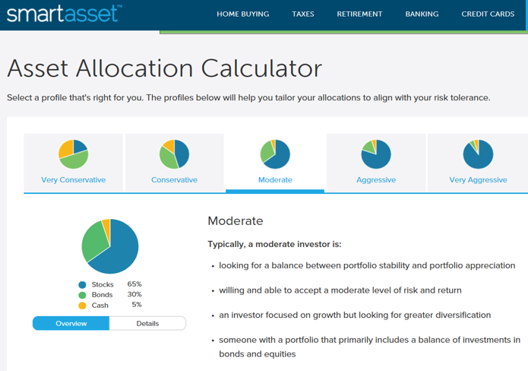
ACTION STEP
Learn more about asset allocation and explore your options with these tools:
https://smartasset.com/investing/asset-allocation-calculator
www.bankrate.com/calculators/retirement/asset-allocation.aspx
www.360financialliteracy.org/Calculators/Asset-Allocator

Slide 14
Step 3: Get dependable financial advice
Look for a fiduciary
Fiduciary professionals put you first and avoid any conflicts of interest.
FIND A GOOD MATCH
A few options include:
  Registered Investment Advisers (RIA)
  Certified Financial Planners®
  Accredited Financial Counselors®
Check it out: Find more detailed explanations for how these and other professionals work.
www.investorprotection.org/downloads/IPT_Getting_Help_2015.pdf

Slide 15
Get dependable financial advice
CONSIDER A HYBRID SERVICE
Combination of computer-generated “robo” services with personal guidance from a financial professional.
Two things to keep in mind:
      You’ll pay a bit more for a hybrid than a robo, between 0.30% and 0.91% of assets per year.
      You may not get a dedicated adviser, as you would at a traditional money-management firm.

Slide 16
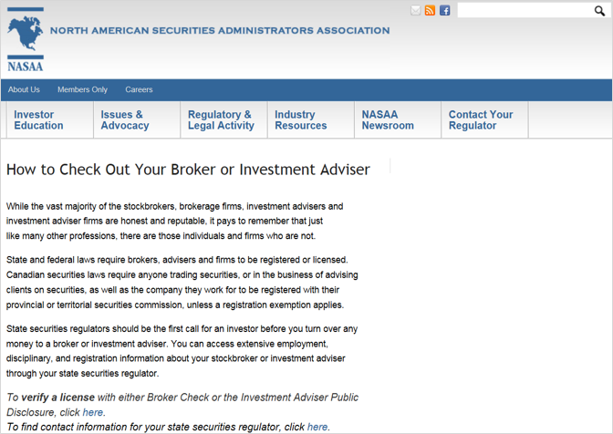
ACTION STEP
Verify a specific adviser
Your State Securities Regulator can confirm an adviser’s licensing and education.
Find your state regulator on the North American Securities Administrators Association website at:
www.nasaa.org/2709/how-to-check-out-your-broker-or-investment-adviser/

Slide 17
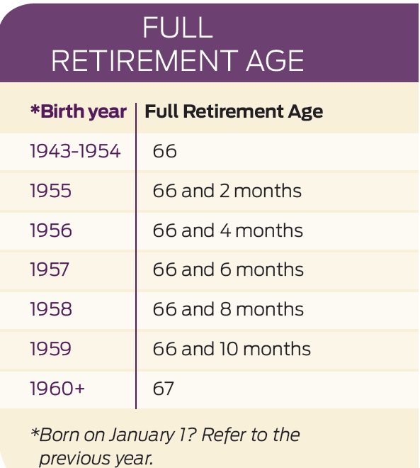
Step 4: Plan to maximize Social Security
ESSENTIAL FACTS
40 “credits” makes you eligible for benefits. You can earn up to four credits a year, so it generally takes 10 years of work to qualify.
The benefit is based on the income from your 35 highest earnings years – even if not consecutive.
You can claim benefits anytime between age 62 and age 70.
The age at which you can claim a full benefit (your Full Retirement Age) is based on the year you were born.

Slide 18
Plan to maximize Social Security
If you start collecting Social Security before your full retirement age:
You’ll collect benefits for a longer time.
But your benefits will be reduced by about 6% each year.
If you wait to claim Social Security after your full retirement age:
You’ll collect benefits for a shorter time.
But your benefits could increase by as much as 8% per year up to age 70.

Slide 19
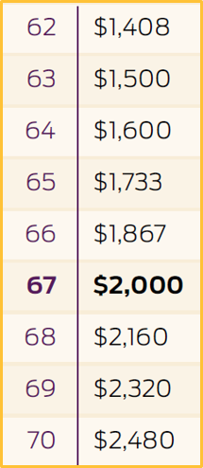
A deeper dive
Let’s say you’re due a monthly benefit of $2,000 at the full retirement age of 67.
Here’s what your benefit would be if you started collecting Social Security earlier or later, not counting cost-of-living increases that apply almost every year.

Slide 20
Plan to maximize Social Security
CLAIMING SPOUSAL BENEFITS
Married? One spouse can take a spousal benefit, worth up to 50% of the other spouse’s benefit.
Example: Your benefit is worth $2,000, but your spouse’s is worth only $500. Your spouse can switch to a spousal benefit worth $1,000 – bringing in $500 more in income per month.
You must be married for one year to claim spousal benefits.
Take note
The calculation changes if benefits are claimed before full retirement age.
You can’t apply for a spousal benefit until your spouse has applied for his or her own benefit.

Slide 21
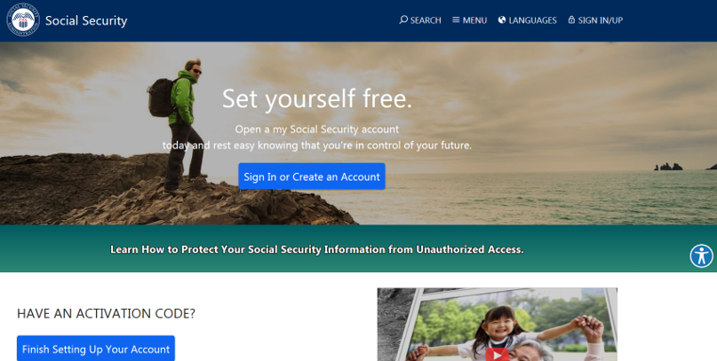
ACTION STEP
Create a “my Social Security” account, www.ssa.gov/myaccount.
You’ll be able to:
Review estimates of future retirement, disability, and survivors’ benefits.
Verify your earnings record to ensure that the amounts posted are correct.

Slide 22
Step 5: Determine when you want to retire
ADD UP POTENTIAL SOURCES OF INCOME
Estimates of Social Security benefits
Guaranteed payments from an employer pension
Non-retirement investment income
Part-time or consulting work
Rental payments, or other income

Slide 23

Determine when you want to retire
REVIEW WITHDRAWAL RULES FOR RETIREMENT ACCOUNTS
Traditional IRAs
Withdrawals allowed without penalties when you turn 59½, and you must take required minimum distributions (RMDs) when you turn 70½ or face steep IRS penalties.
Roth IRAs
You’re not required to take distributions if you’re the original owner. And as long as the account is at least five years old, withdrawals are completely tax-free after you turn 59½.
401(k) or 403(b) Plans
Penalty-free withdrawals can start once you turn 59½, and RMDs are generally required once you hit 70½. An exception: If you’re still working, you won’t have to take RMDs until you retire, which gives your money extra time to grow.

Slide 24
Determine when you want to retire
ESTIMATE FUTURE EXPENSES
Regular expenses
Healthcare
Housing, utilities
Taxes and insurance
Groceries
Property repairs, maintenance
Occasional expenses
Vet bills and holiday gifts
Lifestyle expenses in retirement
Travel
Art/hobby classes
Golfing/sports
Dining/entertainment

Slide 25
Determine when you want to retire
HOW LONG WILL YOUR INCOME LAST?
Calculate the difference between your guaranteed annual income and your essential expenses. That’s the amount you’ll need to withdraw annually from your retirement accounts.
Next, divide your total retirement savings balance by the annual withdrawal you just identified.
The result? That’s the estimated number of years your savings could last. Think of it as a starting point for helping you figure out when you might be able to retire, or what action steps you can take now to retire when you want.

Slide 26
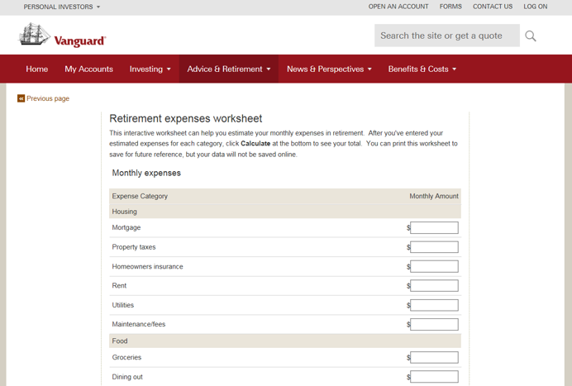
ACTION STEP
Estimate future income and expenses in retirement. Try these tools:
Estimate RMDs, https://www.irs.gov/retirement-plans/plan-participant-employee/required-minimum-distribution-worksheets
Estimate monthly expenses, https://personal.vanguard.com/us/insights/retirement/tool/retirement-expense-worksheet
Calculate how much you need to save, https://www.kiplinger.com/tool/retirement/T047-S001-retirement-savings-calculator-how-much-money-do-i/index.php

Slide 27

Quiz: Test your financial know-how
Now that you’ve learned some smart ways to boost savings and gauge sources of income in retirement, you’re ready to supercharge your progress.
Let’s put your preparedness to the test with these six questions!

Slide 28
Quiz: Test your financial know-how
QUESTION # 1
Seth is really moving up in his career and wants to finally retire some debt, plus take the leap and buy a 40-foot sailboat he’s had his eyes on for years.
He’s watched his money steadily accumulate in his IRA and figures he can go ahead and use some of it early because he’s got lots of time before retirement to make it up.
Is this a wise move?
Smart move. Go for it!
Bad move. Don’t do it!

Slide 29
Quiz: Test your financial know-how
THE ANSWER?
Don’t do it, Seth!
Keep your retirement savings for retirement. It may be tempting to dip into these funds by taking early withdrawals or loans, but doing so amounts to savings sabotage.
You’ll lose out on the momentum of compounding on that money, pay 10% early – withdrawal penalties, and possibly owe taxes, too.
Losing that long-term growth – and paying for doing so – can really take a bite out of your hard-earned savings.

Slide 30
Quiz: Test your financial know-how
QUESTION # 2
You are within 10 years of retiring and your 401(k) balance is down. You should:
Reassess your asset allocation to make sure it’s still appropriate.
Take advantage of extra catch-up contributions for workers age 50 and older.
A
B
A and B

Slide 31
Quiz: Test your financial know-how
THE ANSWER?
Both A and B.
Whether or not your account took a temporary tumble thanks to market performance, it’s wise to review the asset allocation in your portfolio at least once a year. Contributing to your 401(k) will continue to give you upfront tax breaks, and keeping a closer eye on managing risk may be especially appropriate as retirement nears.
Remember, choosing the right mix of investments depends on your personal risk tolerance and time horizon.
At the same time, one way to top off your retirement savings is to prepare to make tax-advantaged “catch up” contributions to your retirement accounts once you turn 50.

Slide 32
Quiz: Test your financial know-how
Question # 3
Over the long term, what’s likely to be the better investment for long-term growth: stocks or bonds?
Stocks
Bonds

Slide 33
Quiz: Test your financial know-how
THE ANSWER?
It’s stocks.
Because stock prices are more volatile than bond prices, it’s true that over the short term, bonds tend to provide more stability to your portfolio than stocks do.
But history shows that over the long term (such as the period over which you are saving for retirement), stocks consistently outperform bonds, giving you a safer cushion against inflation.
Bottom line: There’s a tradeoff in opting for “safe” investments. Safer investments (such as bonds) typically don’t earn as much as riskier ones (including stocks). While your nest egg might be more secure, it’s unlikely to grow as much or as quickly.

Slide 34
Quiz: Test your financial know-how
QUESTION #4
True or false?
The longer you wait to claim Social Security benefits, the more likely you’ll miss out on your fair share.
True
False

Slide 35
Quiz: Test your financial know-how
THE ANSWER?
False.
Quite the opposite. Each year you delay your Social Security benefits past your full retirement age (up to age 70), you receive an 8% increase in benefits per year. The downside of delaying is giving up payments today for higher payments in the future.
Of course, there are reasons to claim sooner – if you have health concerns, for example, or if you think you’ll need the money more in early retirement than when you’re older. So only you can decide when it’s the right time for you.

Slide 36
Quiz: Test your financial know-how
QUESTION # 5
You have a few retirement accounts invested in dozens of different funds. Your spouse has another set of accounts. You both contribute regularly.
Some of these accounts have grown exponentially, thanks to a long-running bull market.
Should you consider consulting a financial adviser?
Yes, I have no idea if our individual investments make sense for us together, going forward.
No, so far so good. I figure everything will even out in the end.

Slide 37
Quiz: Test your financial know-how
THE ANSWER?
Yes, it could be worthwhile to get some guidance from a professional who can analyze your portfolios.
A good financial planner can improve a haphazard collection of investments, for example, by analyzing its risks and returns, its redundancies and unnecessary investments, and the fees and taxes you’re paying.
Ensuring your retirement plan is on track makes sense at this stage, and you can explore one of two approaches: working with a traditional financial professional or choosing the newer breed of hybrid advisers.

Slide 38
Quiz: Test your financial know-how
QUESTION #6
Which of the following expenses do you expect to increase the most in retirement?
Housing
Taxes
Healthcare
A
B
C

Slide 39
Quiz: Test your financial know-how
THE ANSWER?
C. Many people underestimate what they’ll spend in retirement – and healthcare typically leads the list.
One estimate, by HealthView Services, projects that the average 65-year-old couple retiring today will pay $404,253 for lifetime healthcare costs (including premiums, deductibles, co-pays, and other out-of-pocket expenses).
Another estimate, conducted annually by Fidelity Benefits Consulting, pegs average healthcare spending at $275,000 per couple over a 23-year retirement.

Slide 40

Contact information
Presenter’s contact information
Investor Protection Trust www.investorprotection.org

