Slide 1
Notes to presenter
Thank you for participating in the When I’m 65 program and for working to make sure everyone has the information they need to plan for a secure and fulfilling retirement.
This slide set was developed as part of the When I’m 65 program and is designed to be used with the “Starting to Save for Retirement” booklet and the When I’m 65 documentary and complementary video, as part of an investor education course or other educational event, curriculum or course of study.
The content is designed to educate adults ages 25–40 who are just starting their careers and/or who are approaching their prime earning years. They either have not started to save or are just now starting to save for their retirement.
When I’m 65 offers a lot of great video that you can download and include with this presentation including the full documentary. Go to www.wi65.org/video and click on “Information for Millennials.”
The When I’m 65 materials are all independent, unbiased, noncommercial and for educational use only. Facilitators/presenters are prohibited from selling financial or investing products or services as part of the When I’m 65 program.
Add your contact information in the space provided on the final slide of this presentation.
Please delete this slide before the presentation.

Slide 2
Funding your future paycheck
4 steps you can take today

Slide 3
The When I’m 65 program
How we live & thrive in retirement is changing dramatically
The When I’m 65 program is a national public television documentary and a multi-year community engagement program.
The When I’m 65 documentary explores:
          Multi-generational approaches to retirement
      Changing attitudes toward work, debt, housing, and financial fraud
      Choices Americans of all ages must make to plan for a financially secure future
The When I’m 65 community engagement program uses screenings of the documentary, engagement videos, booklets, in-person training, and other resources to stimulate discussions and online activity to help individuals and families prepare for a financially secure retirement.
www.wi65.org | facebook.com/WI65Project | twitter.com/WI65Project

Slide 4
When I’m 65 program partners
The When I’m 65 documentary and community engagement program is made possible by:
The Investor Protection Trust (IPT) is a nonprofit organization devoted to investor education. Since 1993, the Investor Protection Trust has worked with the states and at the national level to provide the independent, objective investor education needed by all Americans to make informed investment decisions.
www.investorprotection.org | facebook.com/InvestorProtectionTrust | twitter.com/IPT_Info
The Investor Protection Institute (IPI) is an independent nonprofit organization that advances investor protection by conducting and supporting unbiased research and groundbreaking education programs.
www.iInvest.org | facebook.com/InvestorProtectionInstitute | twitter.com/IPI-News
Detroit Public Television is a viewer-supported PBS member station located in Wixom, Michigan. Their vision is for a community in which people trust public media to help them discover new ideas, make informed decisions and enjoy enriched lives. The station is notably active in producing programs that showcase arts, culture, news and analysis; and educational outreach campaigns that use the power of media to provide knowledge and understanding. www.dptv.org | facebook.com/detroitpublictv | twitter.com/detroitpublictv

Slide 5
Introduction
Starting out, saving for retirement may be low on your priority list.
There is a great reason to start saving today: The sooner you start, the bigger your nest egg will be.
Spark a savings habit by connecting with your “future self.”

Slide 6
The DIY retirement
You decide if you’ll join your employer’s plan or set up your own.
You choose how much to contribute.
You decide how to invest your savings.
You can use online tools and apps to help you manage your investments.

Slide 7

4 steps to take today
Start saving what you can today to give your money maximum time to grow.
Learn what retirement savings options are available.
Choose investments based on your timeline and risk tolerance.
Select a financial adviser to guide you along the way.
Let’s take a closer look at each of these steps.

Slide 8
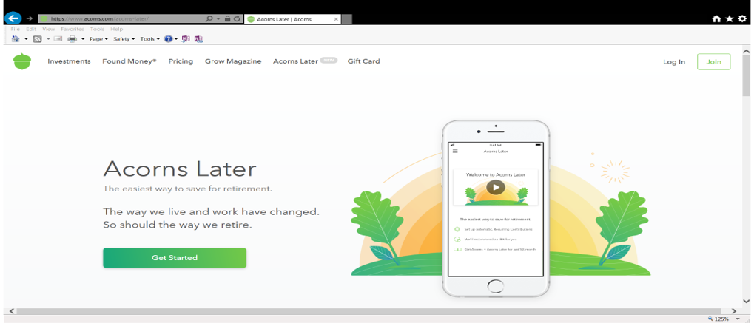
Step 1: Start saving early and often
Set up predetermined regular contributions.
Make automatic contributions to your employer’s plan through payroll deductions.
Contact your bank or HR department to set up transfers to an IRA.
Check it out: The Acorns Later App sets up automatic transfers to an IRA.
www.acorns.com/acorns-later

Slide 9
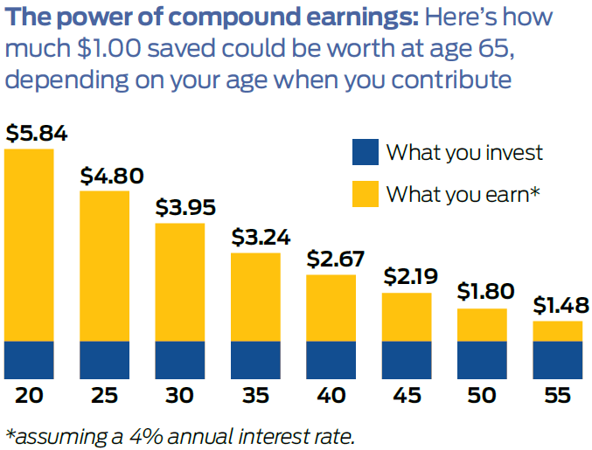
The compounding effect
More time means more money, thanks to the compounding effect.
You save money, and it earns interest.
The next period, you’ll earn interest on your original money + the previous interest.
*assuming a 4% annual rate of return

Slide 10
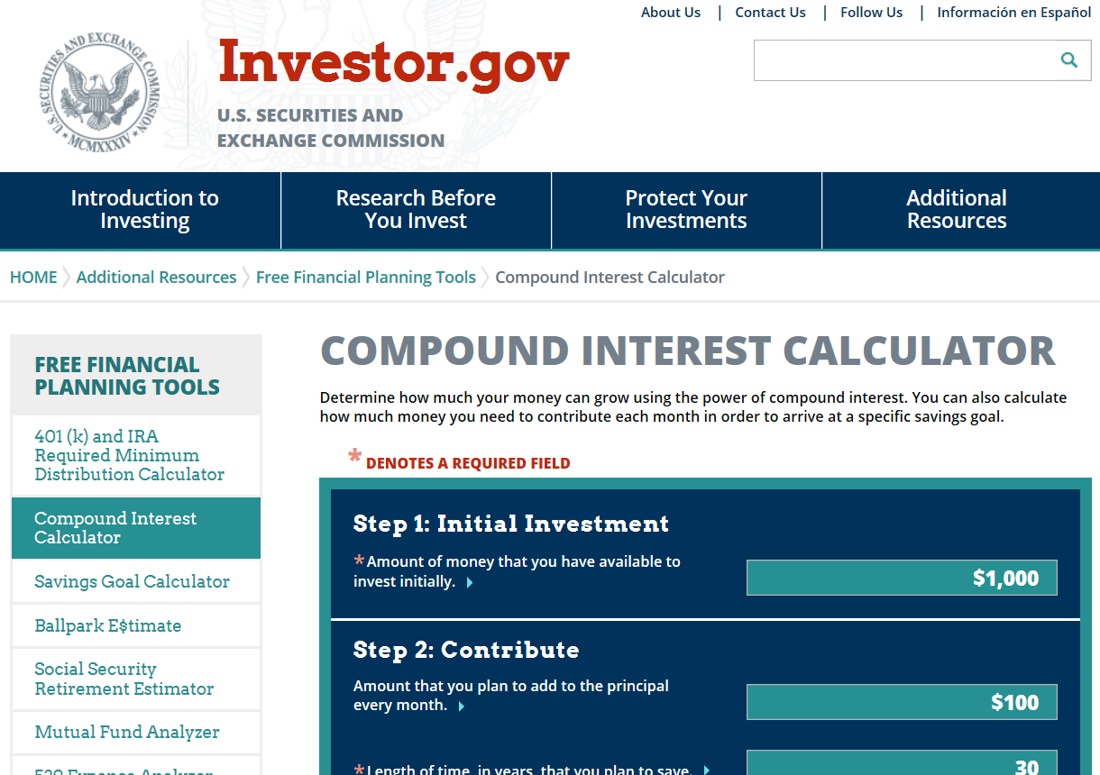
ACTION STEP
Experiment with these calculators to see how your money can grow and how much you need to save to reach your goals.
www.investor.gov/additional-resources/free-financial-planning-tools/compound-interest-calculator
www.bankrate.com/calculators/savings/compound-savings-calculator-tool.aspx
www.360financialliteracy.org/calculators/savings-calculator

Slide 11
Step 2: Understand your retirement options
Enroll in your employer’s plan
Sign up as soon as you’re eligible.
Common plans are 401(k)s for private industry and 403(b)s for public employees or nonprofit agencies.
Contribute up to $18,500 in 2018 for individuals up to age 49; $24,500 for people age 50 and older.
Choose your investments (typically from a variety of mutual funds).
Contributions and earnings grow tax-free until withdrawal.
Some employers may offer a Roth option.

Slide 12
Understand your retirement options
OPEN AN Individual retirement account
Available to anyone who wants to save more, or who doesn’t have access to a retirement plan at work.
Offer a wider range of investment choices than workplace retirement plans do.
Choose from two types: Traditional or Roth

Slide 13
Traditional vs. Roth
key similarities
Money grows tax-deferred. That means you don’t pay taxes on earnings as they accumulate.
Individuals under age 49 can contribute up to $5,500 in 2018 to either or both ($6,500 for people age 50 and older).

Slide 14
Traditional vs. Roth
Key differences
Contributions: Traditional IRAs use pre-tax dollars; Roth IRAs use after-tax dollars.
Earnings: Traditional IRAs are taxed when you take the money out; Roth IRAs are tax-free in retirement.
Tax and penalties: With traditional IRAs, you pay taxes on withdrawals, plus a 10% penalty if you’re under 59½. With Roth IRAs, there are no taxes or penalties for taking contributions, plus withdrawal of earnings is tax-free if you’ve owned the account for at least five years and are at least 59½.
Required minimum distributions are due from traditional IRAs once you turn 70½, but not for Roth IRAs.
No income limits apply for contributing to a traditional IRA; Contributions to Roth IRAs are limited for singles earning more than $135,000; $199,000 for married couples in 2018.

Slide 15
Key decision point
Expect your tax rate to be higher when you retire?
  Choosing Roth means passing up a tax break now to claim a more valuable break later.
Think your tax rate will be lower after retirement?
  Selecting a traditional IRA would let you claim a higher break now.
To choose between a traditional or Roth IRA, consider your income rate now and in the future.

Slide 16
Understand your retirement options
Explore plans for the self-employed
Solo 401(k). You can contribute up to $55,000 in 2018, and set up the account as either traditional or Roth.
SEP-IRA. Simplified Employee Pension IRAs also let you contribute up to $55,000 for 2018.
Defined benefit plans (personal pensions for high earners). Annual contributions are required, along with setup and annual service fees. Geared toward very high earners, with a maximum annual benefit of $220,000 in 2018.

Slide 17
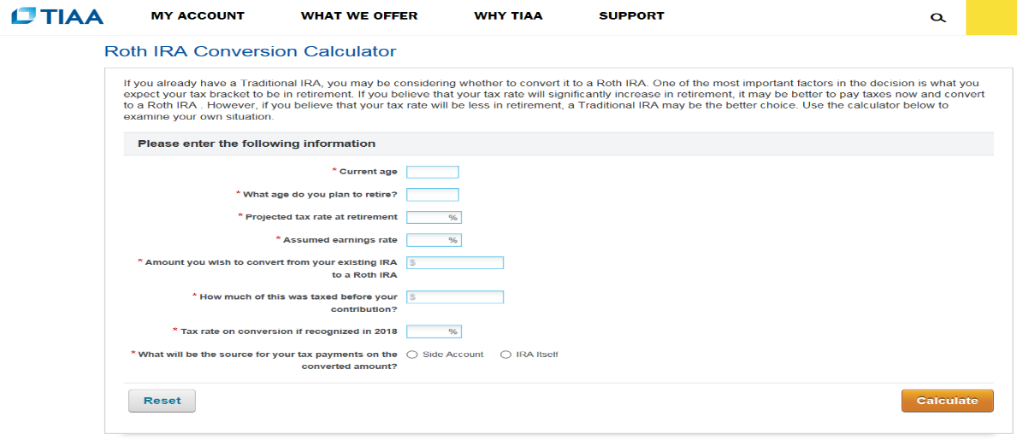
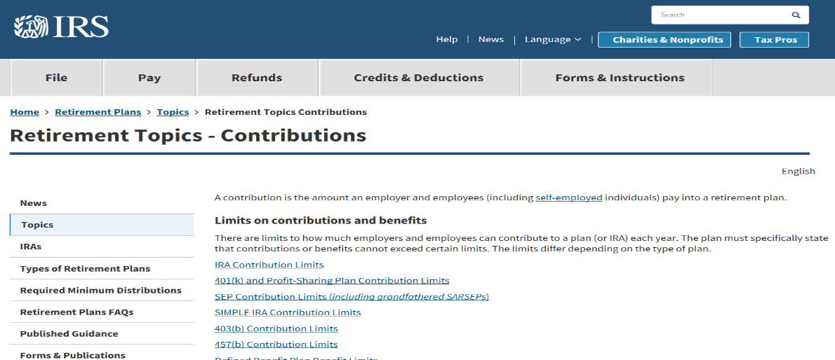
Understand your retirement options
Check it out: Assess potential savings for Roth vs. traditional IRAs with TIAA’s comparison tool.
Check it out: Find the current contribution limits for a range of retirement plans on the IRS website.
www.tiaa.org/public/calcs/rothiracalculator
www.irs.gov/retirement-plans/plan-participant-employee/retirement-topics-contributions

Slide 18
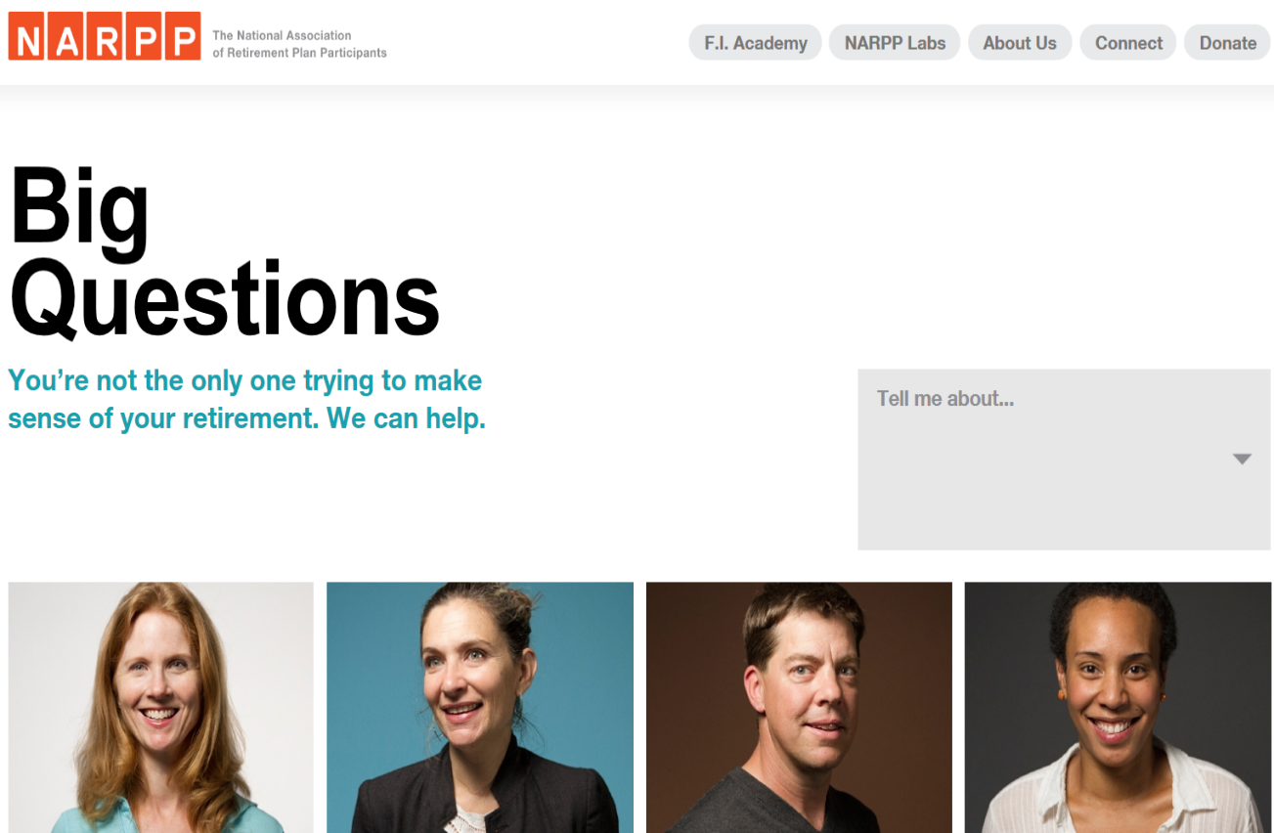
ACTION STEP
Understand the rules regarding both contributions and withdrawals. Check out resources like these:
National Association of Retirement Plan Participants, www.narpp.org/
Types of Retirement Plans, IRS, www.irs.gov/retirement-plans/plan-sponsor/types-of-retirement-plans
Smart About Money, www.smartaboutmoney.org/
Maximize Your Retirement Investments, Investor Protection Trust, www.investorprotection.org/downloads/IPT_Retirement_2015.pdf

Slide 19
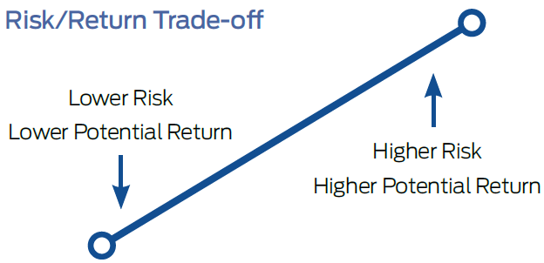
Step 3: Create your ideal portfolio
UNDERSTAND YOUR RISK TOLERANCE
The value of investments can rise or fall over time.
If retirement is far off, time may allow for your portfolio to recover — allowing you to take more risk than you could if you had to retire in just a few years.
“Safe” investments (vs. riskier ones) may bring security, but lower returns.

Slide 20
Create your ideal portfolio
Diversify your investments
A mix of assets can cushion the risk of losses.
Inside your retirement account, you decide what you want to invest in each type of asset.
Owning different shares of each type of investment diversifies your holdings within each asset class.
Stocks and bonds are the main types of retirement-plan assets.

Slide 21
Create your ideal portfolio
Stocks represent pieces of ownership in a company, with unlimited growth potential and the risk that the company could perform poorly and lose value.
Bonds are more like loans to a company or government, with guaranteed interest and principal payments; they don’t have the same growth potential as stocks but carry less risk that you’ll lose your money.

Slide 22
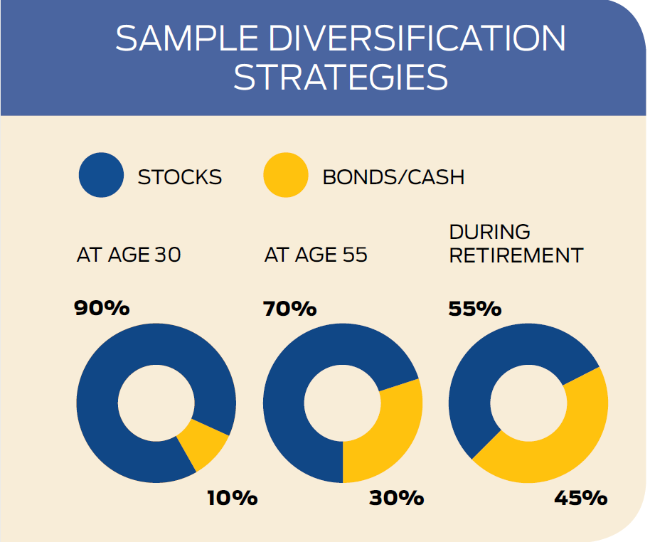
Asset allocation
Increase higher-return investments early in your career.
Consider changes in your personal situation such as:
Getting married
Buying a house
Having children
Revisit mix of retirement holdings at least once a year.

Slide 23
Create your ideal portfolio
Consider target date funds
Mutual funds based on the approximate year you plan to retire.
Automatically adjust holdings toward more conservative investments as target date approaches.
Designed to be the only investment in your retirement portfolio; holding other funds defeats their purpose.
Each fund takes its own “glide path” and timetable toward conservative holdings.
Know whether it’s a “to” fund or a “through” fund.
“To” funds aim to reach their most conservative portfolio mix on the target date.
“Through” funds won’t hit that final portfolio until after the target date, taking fund holders through retirement.

Slide 24
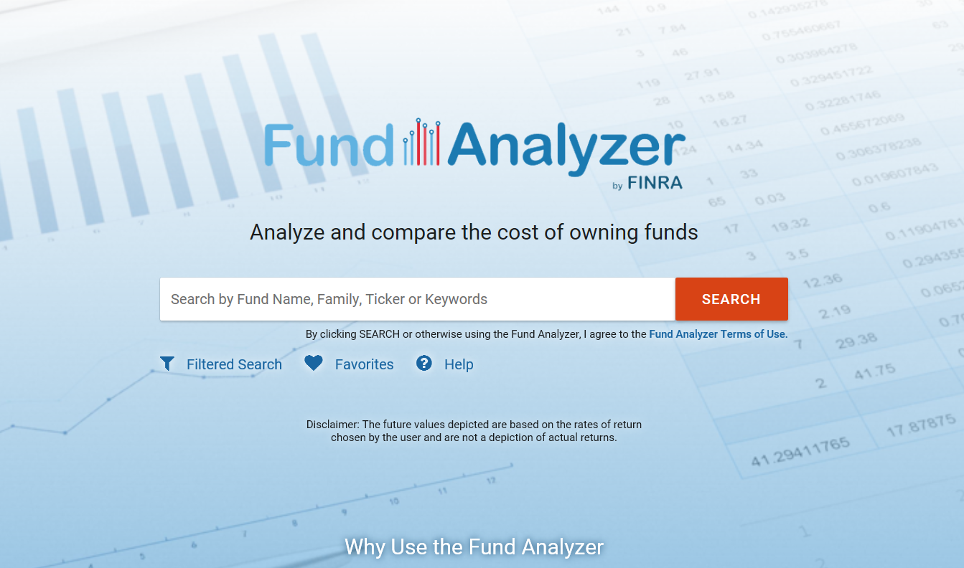
Create your ideal portfolio
KEEP AN EYE ON FUND FEES
Managed funds have higher fees, because they count on financial professionals to actively choose every asset and decide when to buy or sell for best gain.
Passive funds have lower fees, because they include a preset list of stocks (or bonds), usually based on an index, such as the S&P 500.
Check it out: Search a database of 30,000 funds with FINRA’s Fund Analyzer Tool.
https://tools.finra.org/fund_analyzer/

Slide 25
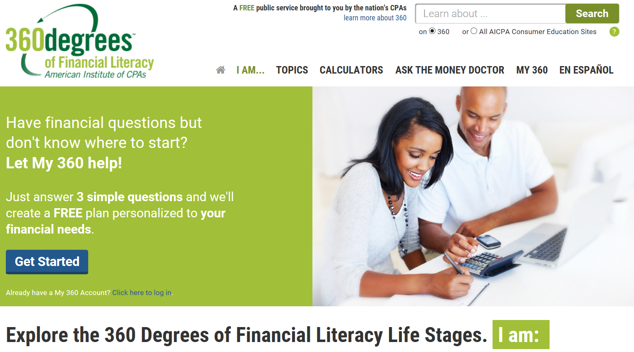
ACTION STEP
Check out resources like these to discover more about the types of investments available:
360 Degrees of Financial Literacy, American Institute of CPAs, www.360financialliteracy.org/
The Basics for Investing in Stocks, Investor Protection Trust, www.investorprotection.org/downloads/IPT_Stocks_2015.pdf
A Primer for Investing in Bonds, Investor Protection Trust, www.investorprotection.org/downloads/IPT_Bonds_2015.pdf
Mutual Funds and ETFs: Maybe All You’ll Ever Need, Investor Protection Trust, www.investorprotection.org/downloads/IPT_Mutual_Funds_2015.pdf

Slide 26
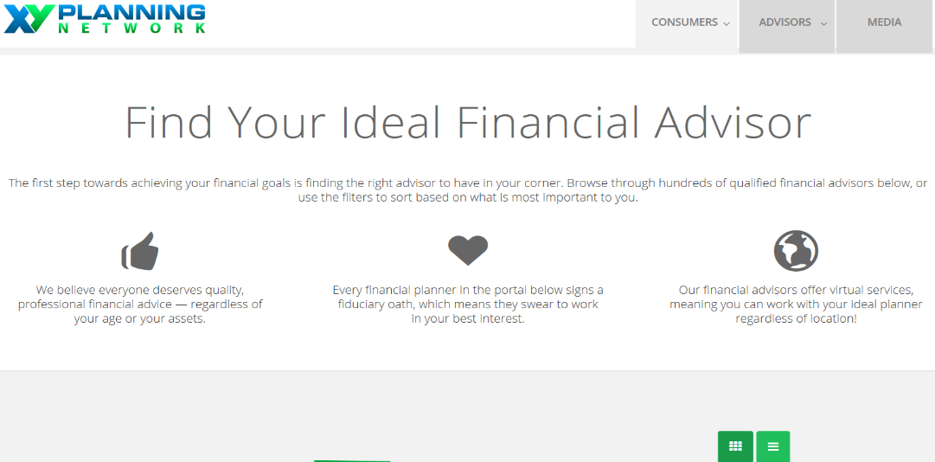
Step 4: Get great financial advice
Look for a fiduciary
Fiduciary professionals put you first and avoid any conflicts of interest.
These advisers work for fee-based compensation, so their pay is the same no matter which investments you make.
Typical fees run about 1% of the value of your investments per year; some charge more, others less.
Check it out: Find a fee-only adviser who specializes in helping younger clients.
www.xyplanningnetwork.com/consumer/find-advisor/

Slide 27
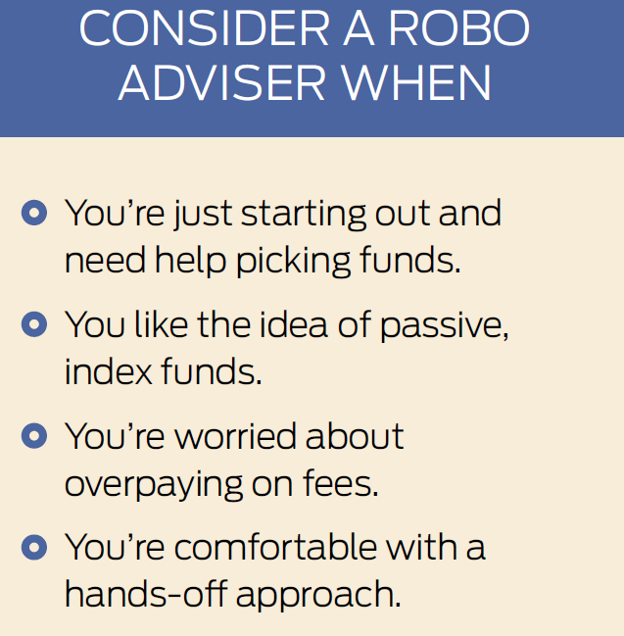
Going ‘robo’
Automated services that use complex algorithms to match you with a diversified portfolio of low-fee funds.
Robos monitor and rebalance your portfolio with almost no human touch.
May be best for investors with fairly simple investing needs and who don’t mind a hands-off style.

Slide 28
Get great financial advice
Choose a hybrid service
Newer platforms combine robo advice with input from certified financial planners.
Hybrids typically charge between 0.30% and 0.91% of assets per year, a bit more than a robo adviser.
You may not be assigned a dedicated adviser, as you would at a traditional money-management firm.

Slide 29
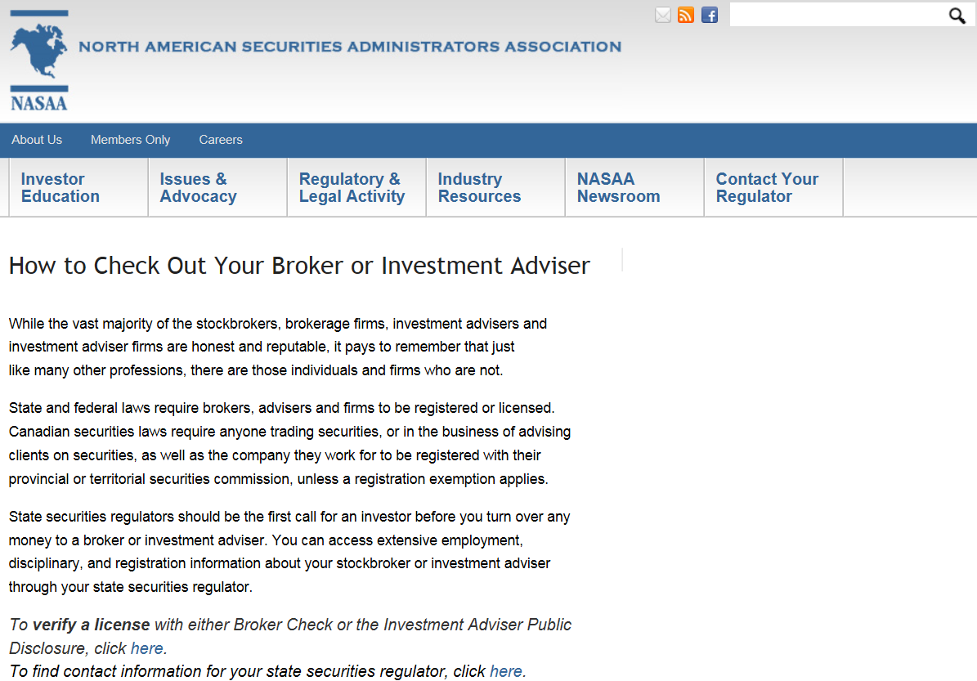
ACTION STEP
Check out a specific adviser. Your State Securities Regulator can confirm an adviser’s licensing and education. Find your state regulator on the North American Securities Administrators Association website at: www.nasaa.org/2709/how-to-check-out-your-broker-or-investment-adviser/
Investigate robo advisers. Subscribe to The Robo Report to receive a free report rating the largest services by performance in equity, fixed income and total portfolio at: https://theroboreport.com/

Slide 30

Quiz: Test your financial know-how
Now that you've learned more about key ways to launch your retirement savings, you're ready to put a plan into action.
Let’s put your knowledge to the test with these six questions!

Slide 31
Quiz: Test your financial know-how
Question #1
Ashley, age 20, contributes $3,000 per year to an individual retirement account for 10 years, then stops, letting her money sit in the account.
Adam, age 30, contributes $3,000 each year to an IRA for 35 years.
Who will have more money at age 65, assuming they get identical investment returns of 8% annually?
Ashley will have more money.
Adam will have more money.
Ashley and Adam will have equal amounts.

Slide 32
Quiz: Test your financial know-how
The answer?
Given the same return on their investments, thanks to the magic of compounding Ashley comes out ahead.
Even though she stopped contributing after only 10 years, her money will grow to about $694,000 by the time she retires, assuming an 8% annual return.
Adam, who got a late start, but pitched in more money out of pocket, will amass about $558,000.

Slide 33
Quiz: Test your financial know-how
Question #2
True or false:
You can withdraw contributions you made to a Roth IRA at any time, for any purpose without paying any taxes or penalties, and without having to pay it back — ever.
True, Roth IRAs are big on flexibility.
False, that sounds too good to be true.

Slide 34
Quiz: Test your financial know-how
The answer?
It’s true! The money you put into your Roth IRA is yours for the taking — even if you aren't retired.
The additional money your account earns from your contributions, however, cannot be touched until you’re 59½ and have had a Roth for at least five years. Otherwise, you'll owe taxes and a 10% early withdrawal penalty on earnings.
One exception: Once the money’s been in your account for five years, you can tap your earnings to buy your first home.

Slide 35
Quiz: Test your financial know-how
Question #3:
True or false:
Risk plays a big role in retirement investing because markets can be unpredictable. That’s why you should stick with ultra-safe investments while you’re young.
True, I want to protect my future nest egg at all costs.
False, I want my nest egg to grow with a smart mix of investments.

Slide 36
Quiz: Test your financial know-how
The answer?
False. While it’s true that the value of investments can rise or fall, sticking with “safe” investments carries its own share of risk. That’s because safer investments (like bonds) typically don’t earn as much as riskier ones (like stocks).
While your nest egg might be more secure, it won’t grow as much or as quickly, resulting in less money when you’re ready to retire. The point is that when you’re young, you have time for a diversified portfolio to recover from losses in any given year.

Slide 37
Quiz: Test your financial know-how
Question #4
Which of the following statements about target date funds are correct?
They’re named for the year you aim to retire, such as Retirement 2050.
They invest in and automatically rebalance a mix of assets.
They all follow the same timetable for adjusting toward more conservative investments.
A and C
B and C
A and B

Slide 38
Quiz: Test your financial know-how
The answer?
A and B are correct. Target date funds don’t take a uniform approach as the target date nears.
While all generally provide for more investment in stocks for younger investors and more investments in fixed income for investors near or at retirement, the paths used by different fund providers vary.
Some funds will reach their most conservative asset mix at or shortly after the target date. Others reach their most conservative asset mix 10, 20, or more years after the target date.

Slide 39
Quiz: Test your financial know-how
Question #5
True or false:
Buying a single company's stock usually provides a safer return than a stock mutual fund or exchange-traded fund.
True
False

Slide 40
Quiz: Test your financial know-how
The answer?
False. Investing in a mutual fund or ETF is less risky than investing in a single stock because stock funds offer a way to diversify.
Funds make it easy to diversify your portfolio because they hold a wide variety of investments. For example, a stock fund might hold 350 different stocks, many more than you would likely buy on your own.
By spreading your risk, it’s less likely that a price decline for any single stock will impact your return.

Slide 41
Quiz: Test your financial know-how
Question #6
Which of the following accurately describe what you should expect from a fiduciary?
A. Shouldn’t offer you a product or service if it’s not the best option available to meet your needs.
B. Must disclose any potential conflicts of interest that could influence their recommendations.
C. Will clearly inform you of all fees and commissions.
D. All of the above.
A
B
C
D

Slide 42
Quiz: Test your financial know-how
The answer?
It’s D, all of the above. Fiduciary professionals are legally and ethically obligated to put you first, and avoid any conflicts of interest.
Unlike brokers, whose advisory standard is “suitability” and who can earn higher commissions if you make more or certain trades, fiduciary financial advisers can help you:
Set financial goals.
Choose specific investments.
Make adjustments to your plans as needed – for a set fee (no matter what investments you decide to make).

Slide 43

Contact information
Presenter’s contact information
Investor Protection Trust www.investorprotection.org

