Slide 1
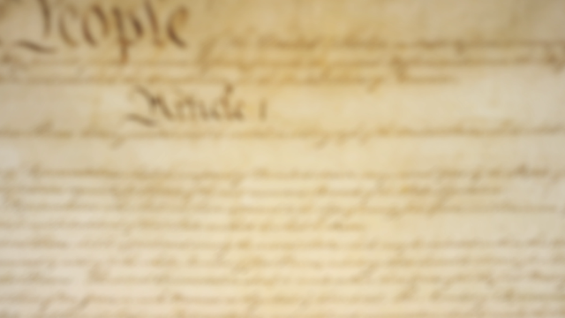




Slide 2
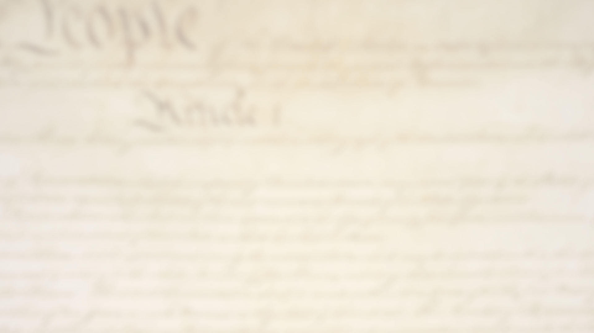
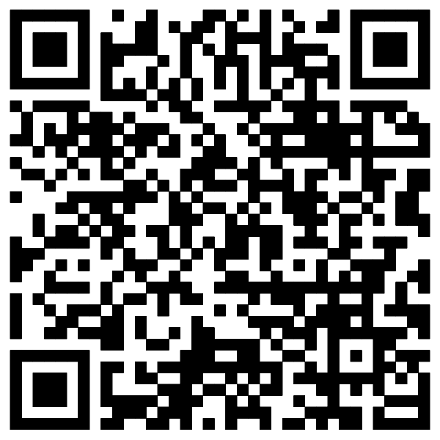
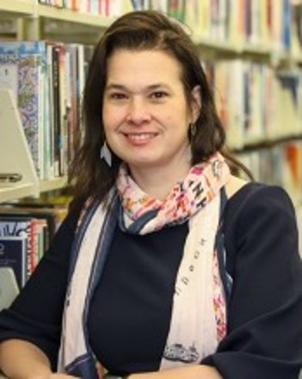
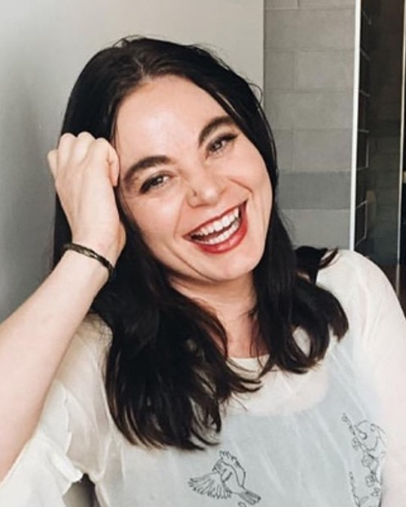
Discover More:
HEATHER-MARIE MONTILLA
MANDI HARRIS
National Director,
PBS Books
Museum and Library
Engagement Coordinator,
PBS Books
hmontilla@pbsbooks.org
mharris@pbsbooks.org
Contact Information

Slide 3
Discover More:
Programs
Contact Information

Slide 4
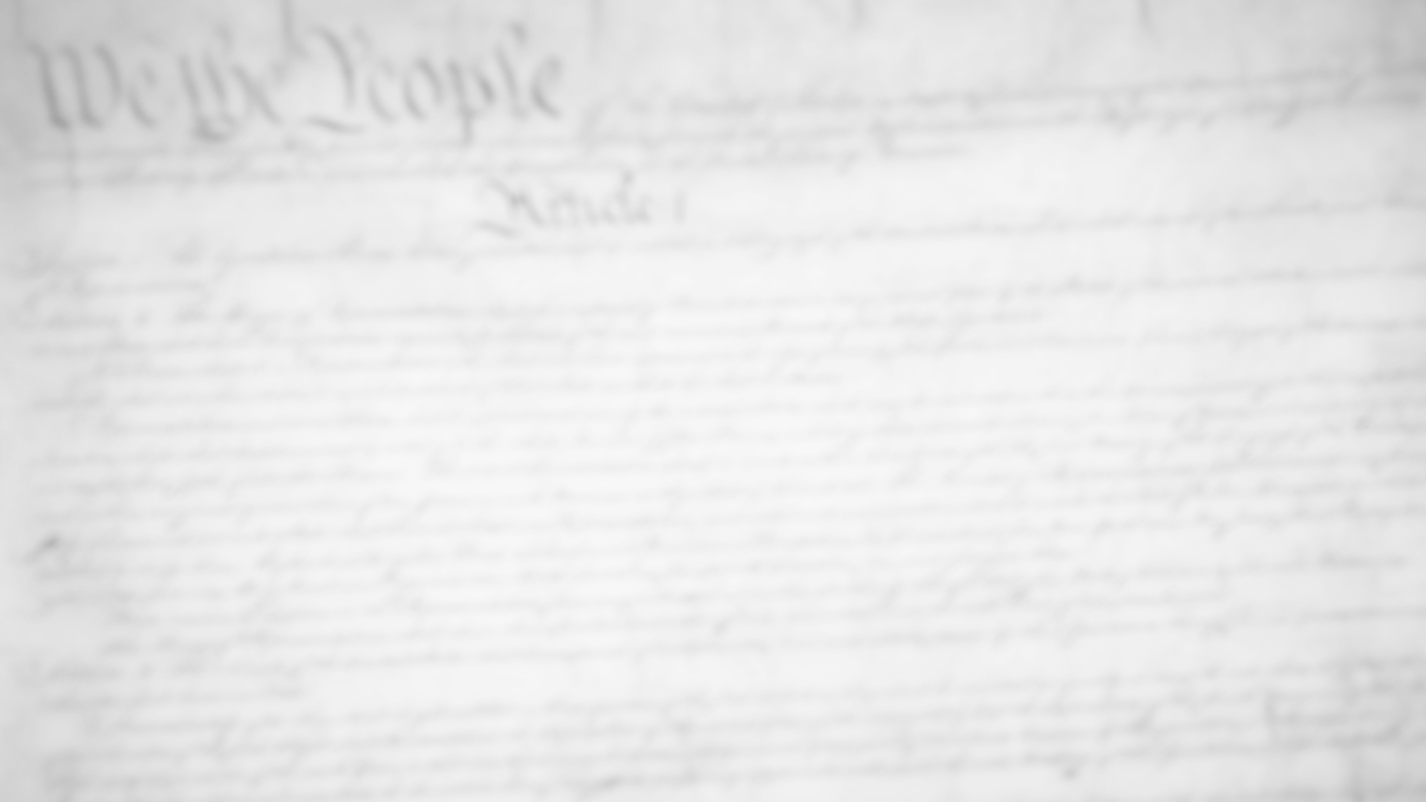
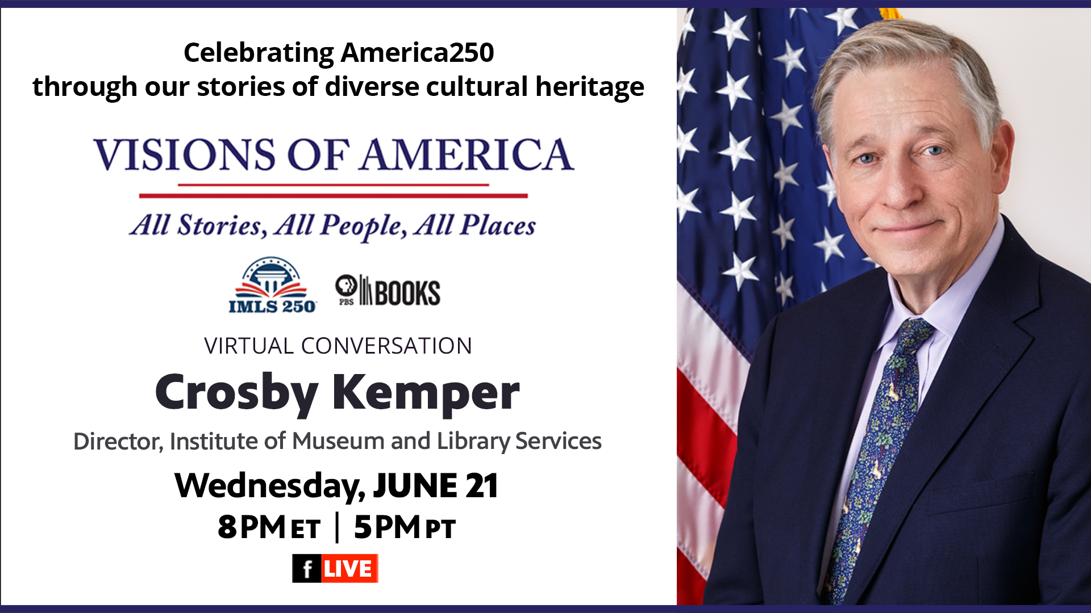
Discover More:
PBS Books, in partnership with the Institute of Museum and Library Services (IMLS), is pleased to present “Visions of America: All Stories, All People, All Places—a celebration of the 250th anniversary of our nation's founding
Celebrating America 250
Through Our Stories of Rich Cultural Heritage

Slide 5
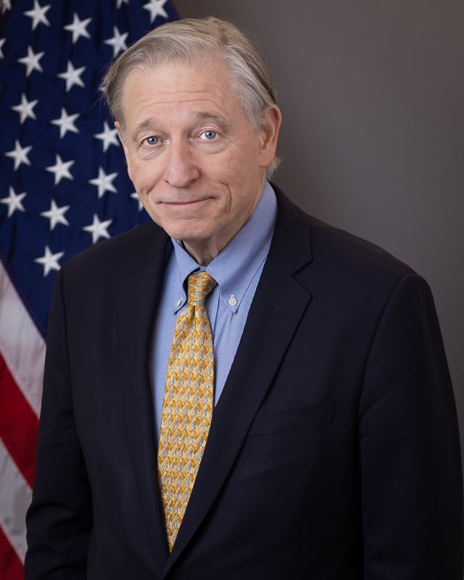
Discover More:
Crosby Kemper
Heather-Marie Montilla
Former Director,
IMLS
National Director,
PBS Books
Celebrating America 250
Through Our Stories of Rich Cultural Heritage

Slide 6

Discover More:
A conversation exploring America’s founding documents, its promises, American society and our crucial citizen responsibilities. Both authors of outstanding books, Allen and Levin are considered to be among the foremost thinkers about American history, especially the Constitution, as it relates to contemporary society.
Our Founding Documents

Slide 7
Discover More:
Crosby Kemper
Danielle Allen
Yuval Levin
Former Director,
IMLS
American Classicist,
Political Scientist, Professor,
James Bryant Conant University
American Conservative
Political Analyst,
Academic, Journalist
Our Founding Documents

Slide 8
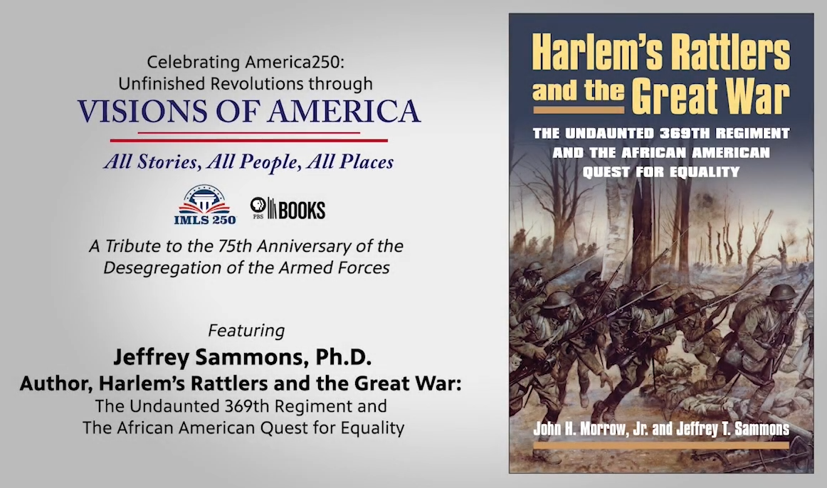
Discover More:
Author, Professor Jeffrey Sammons, discusses his book, Harlem Rattlers and the Great War: The Undaunted 369th Regiment and the African American Quest for Equality, to promote and bolster our conversation The 75th Anniversary of the Desegregation of the Armed Forces.
Jeffrey Sammons, PhD.
Author, Harlem’s Rattlers and the Great War

Slide 9
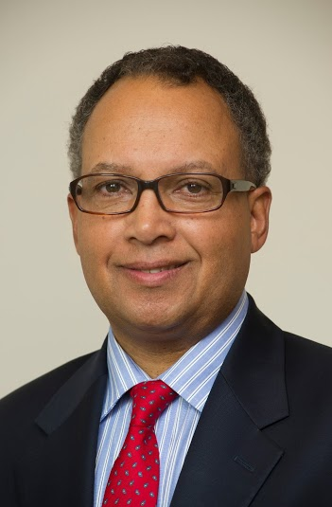
Discover More:
Heather-Marie Montilla
Jeffrey Sammons, PhD.
National Director,
PBS Books
Professor Emeritus of History
New York University,
Author
Jeffrey Sammons, PhD.
Author, Harlem’s Rattlers and the Great War

Slide 10
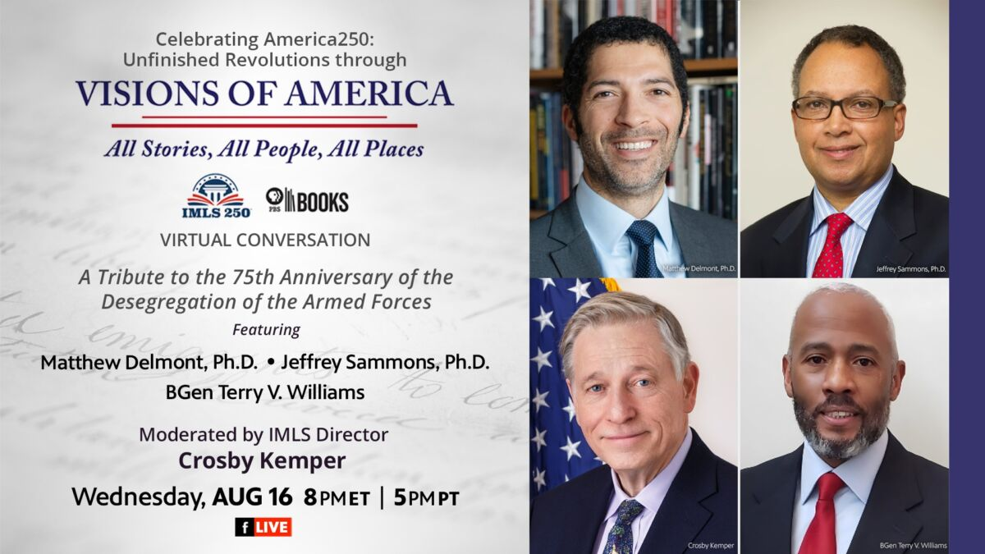
Discover More:
Commemorating the 75th anniversary of the desegregation of the Armed Forces. This conversation will explore the role people of color played in the armed forces from the Revolutionary War through the passage of President Harry Truman’s Executive Order 9981, which created the President's Committee on Equality of Treatment and Opportunity in the Armed Services and beyond. Connecting to our earlier conversations about our country’s promises and obligations, this program will highlight the important role of African Americans and people of color in our country’s history and wars, which has often been overlooked. Join us to explore this important topic.
The 75th Anniversary of the Desegregation of the Armed Forces

Slide 11
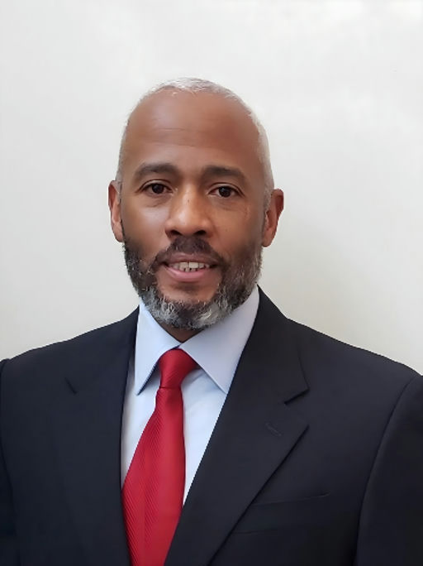
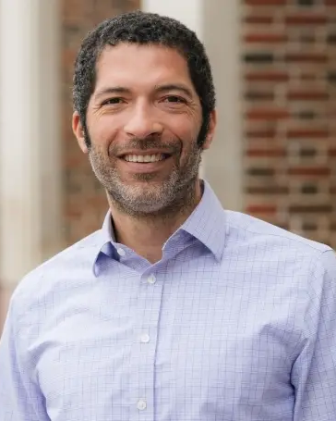
Discover More:
Crosby Kemper
Jeffrey Sammons, PhD.
Terry V. Williams
Matthew Delmont, PhD.
Former Director,
IMLS
Author &
Professor Emeritus of History,
New York University
Brigadier General
USMC (Ret)
Distinguished Professor, Sherman Fairchild Professor of History
The 75th Anniversary of the Desegregation of the Armed Forces

Slide 12

Discover More:
Matthew F. Delmont, who is the Sherman Fairchild Distinguished Professor of History at Dartmouth College. A Guggenheim Fellow and expert on African American history and the history of civil rights, shares about his critically acclaimed and award-wining book, Half American
Matthew Delmont, PhD.
Author, Half American

Slide 13
Discover More:
Heather-Marie Montilla
Matthew Delmont, PhD.
National Director,
PBS Books
Distinguished Professor, Sherman Fairchild Professor of History
Matthew Delmont, PhD.
Author, Half American

Slide 14
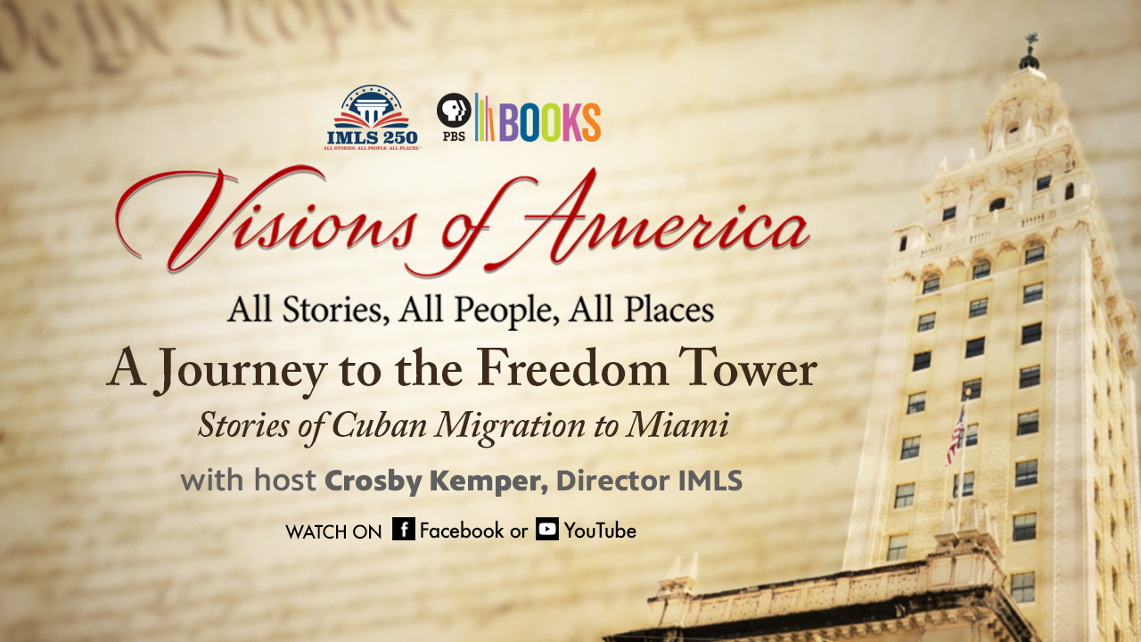
Discover More:
The Freedom Tower (or Torre de la Libertad) in Miami has graced the city’s skyline for nearly a century, but it wasn’t until it played a crucial role in hosting Cuban refugees who fled their home country in the wake of the Cuban Revolution in 1959 that it became an important national landmark.
A Journey to the Freedom Tower
Stories of Cuban Migration to Miami

Slide 15
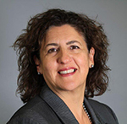
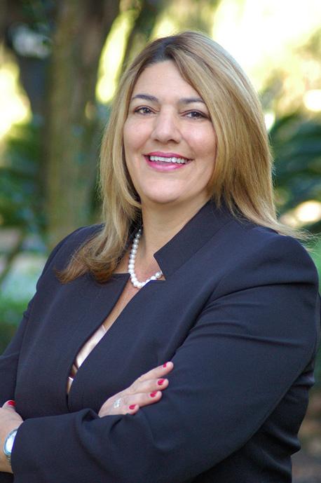
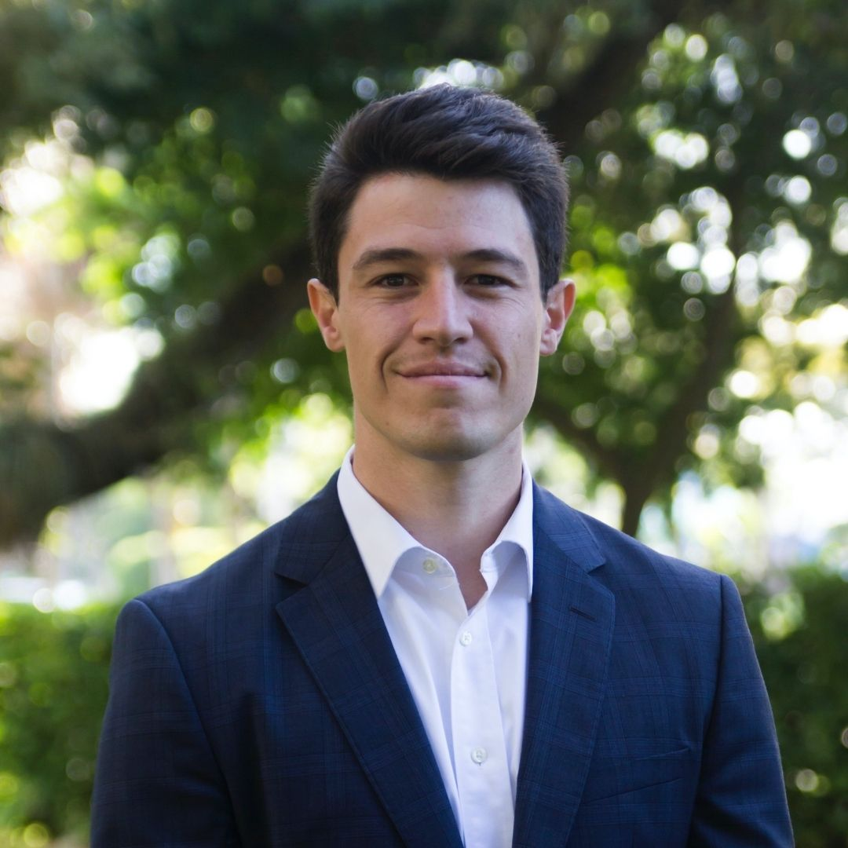
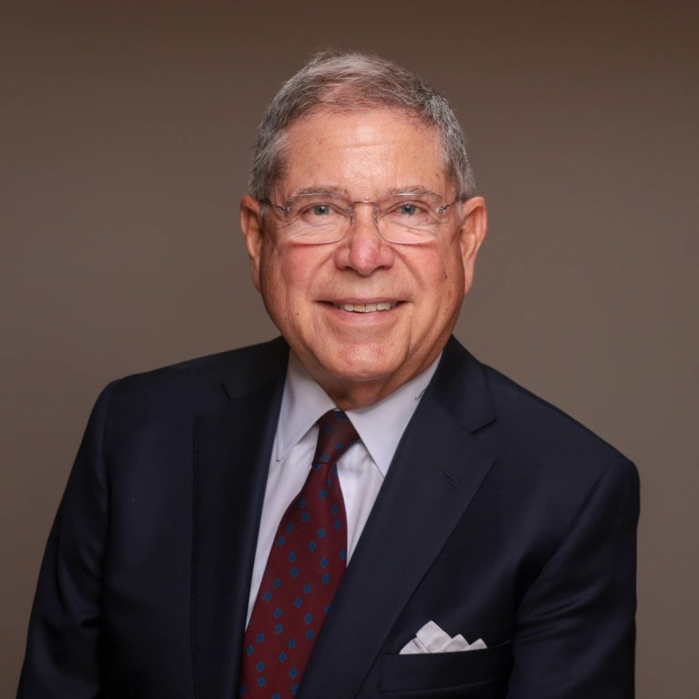
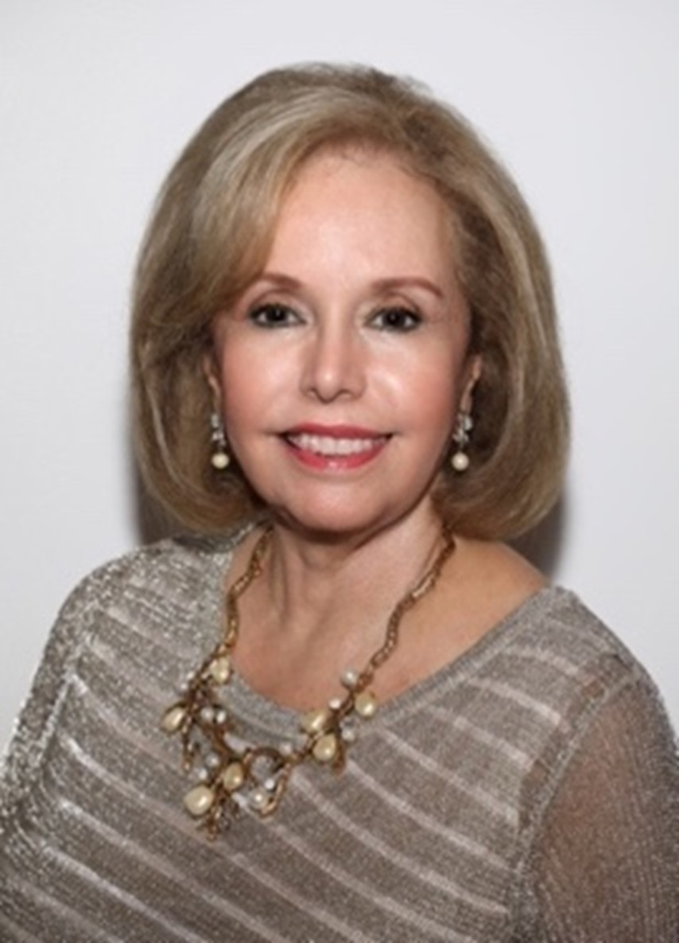
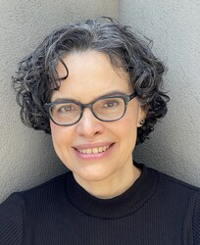
Discover More:
Also
Featured:
Crosby
Kemper
Dean Magda Castineyra
Madeline Pumariega
Alessandro D’Amico
Alberto Ibargüen
Aida Levitan, Ph.D.
Ada Ferrer
Sam Verdeja
Former Director, IMLS
Dir. Honors College Dual Language Program, Miami Dade College
President, Miami Dade College
Dir. Media & Democracy, John S. and James L. Knight Foundation
Pres. & CEO, The John S. and James L. Knight Foundation
Member of the Board & immediate past Chair, USCB Financial Holdings
Julius Silver Professor of History & Latin American and Caribbean Studies at New York University
Author
A Journey to the Freedom Tower
Stories of Cuban Migration to Miami

Slide 16
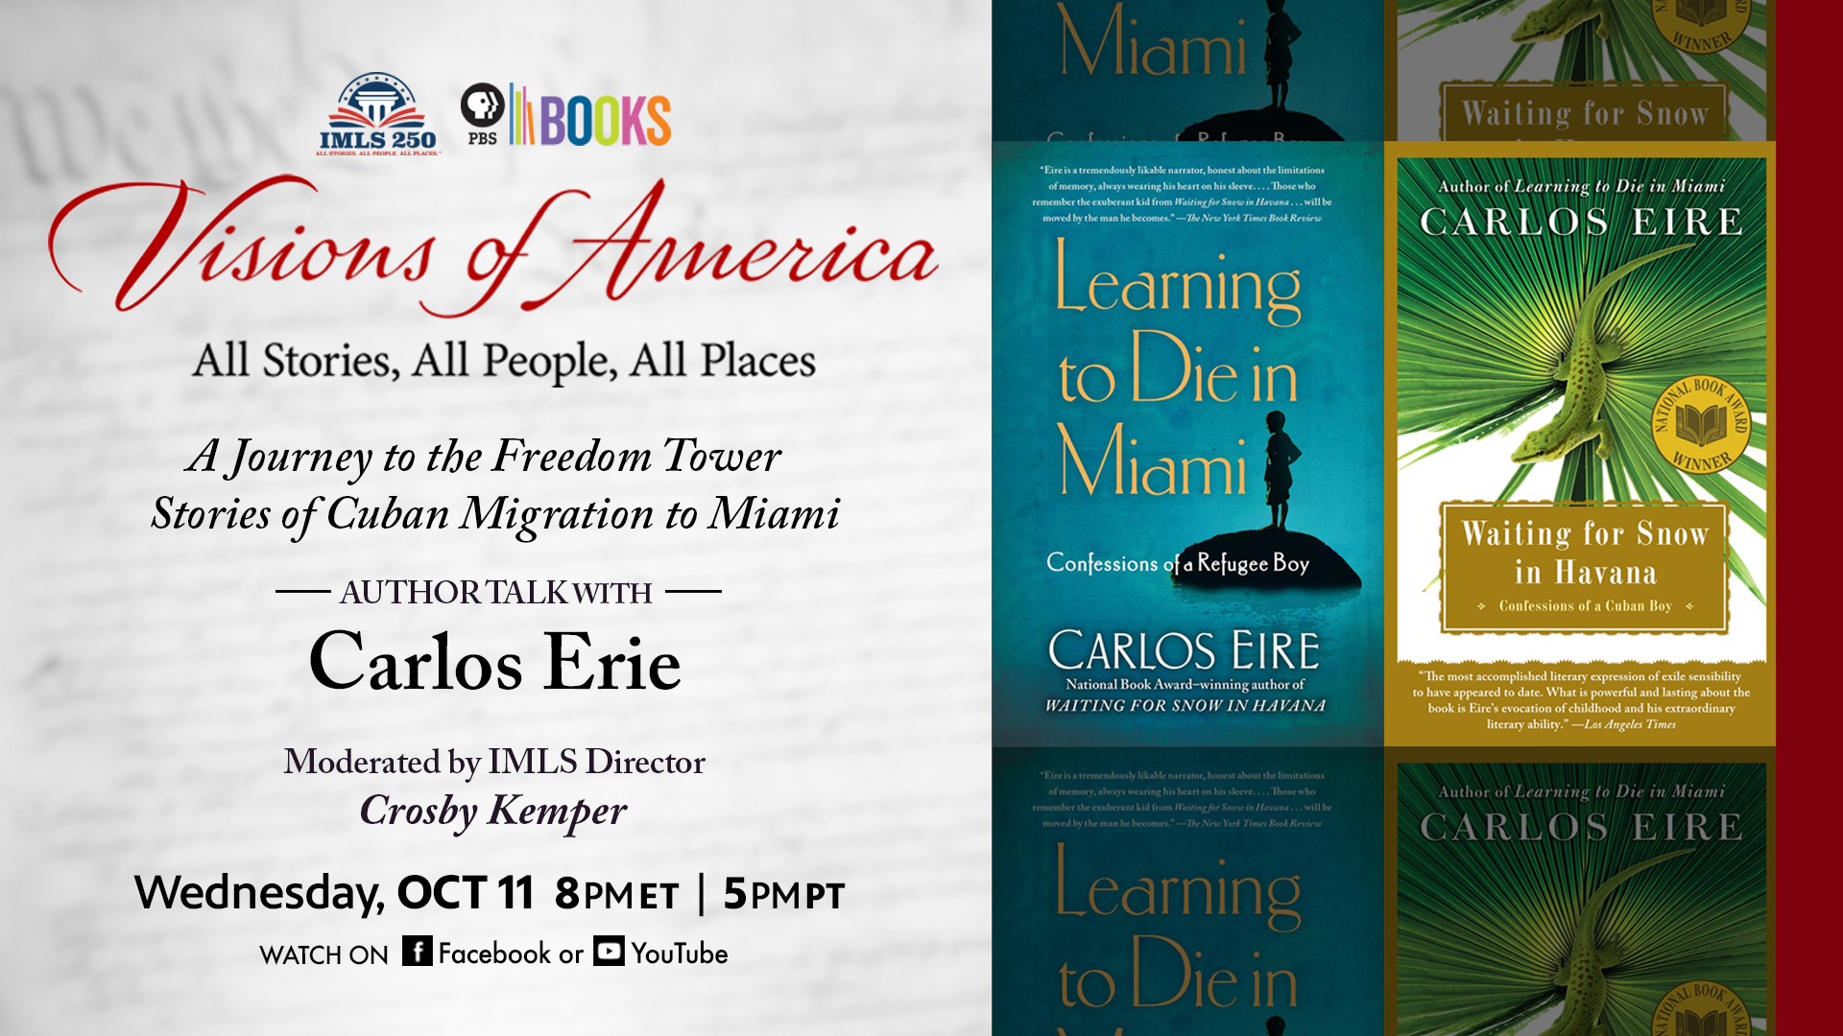
Discover More:
PBS Books premiered VISIONS OF AMERICA: A JOURNEY TO THE FREEDOM TOWER Stories of Cuban Migration to Miami in September. The inspiration for this episode is Carlos Eire’s Waiting for Snow in Havana and Learning to Die in Miami. Award-winning writer and scholar Carlos Eire, discuss his books, his life, and his experiences as an immigrant, an exile and an American. Gain personal insights into a Cuban’s experience and Pedro Pan, an unaccompanied children’s exodus from Cuba.
Carlos Erie
Author, Waiting for Snow in Havana and Learning to Die in Miami

Slide 17
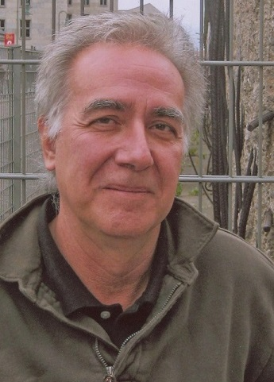
Discover More:
Crosby Kemper
Carlos Erie
Former Director,
IMLS
Author
Carlos Erie
Author, Waiting for Snow in Havana and Learning to Die in Miami

Slide 18
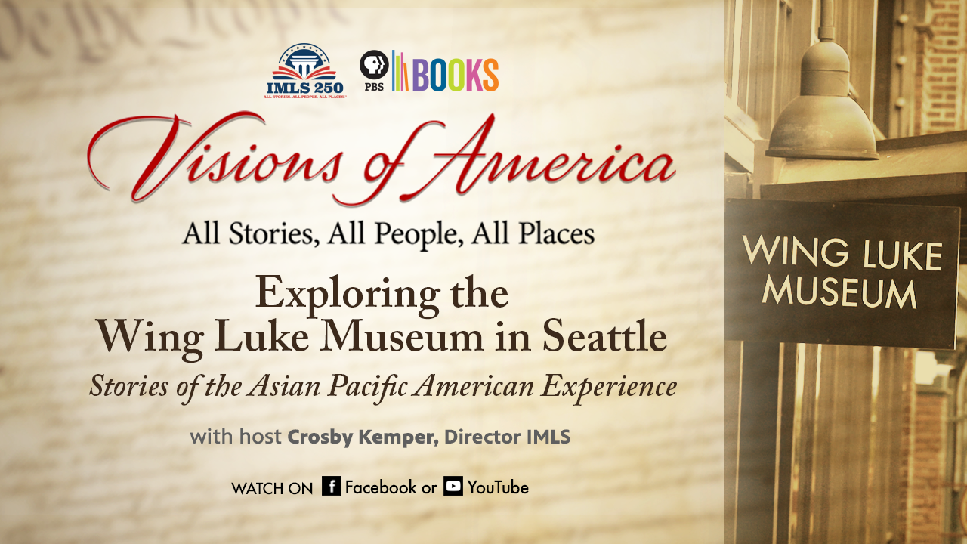
Discover More:
Explore the Asian American Pacific Islander (AAPI) history and culture in Seattle beginning with a visit to the Wing Luke Museum. Established in 1967, Wing Luke Museum is a museum that focuses on art, history, and culture of Asian Americans, Pacific Islanders, and Native Hawaiians; it is the only pan-Asian community-based museum in the US.
Exploring the Wing Luke Museum in Seattle
Stories of the Asian Pacific American Experience

Slide 19
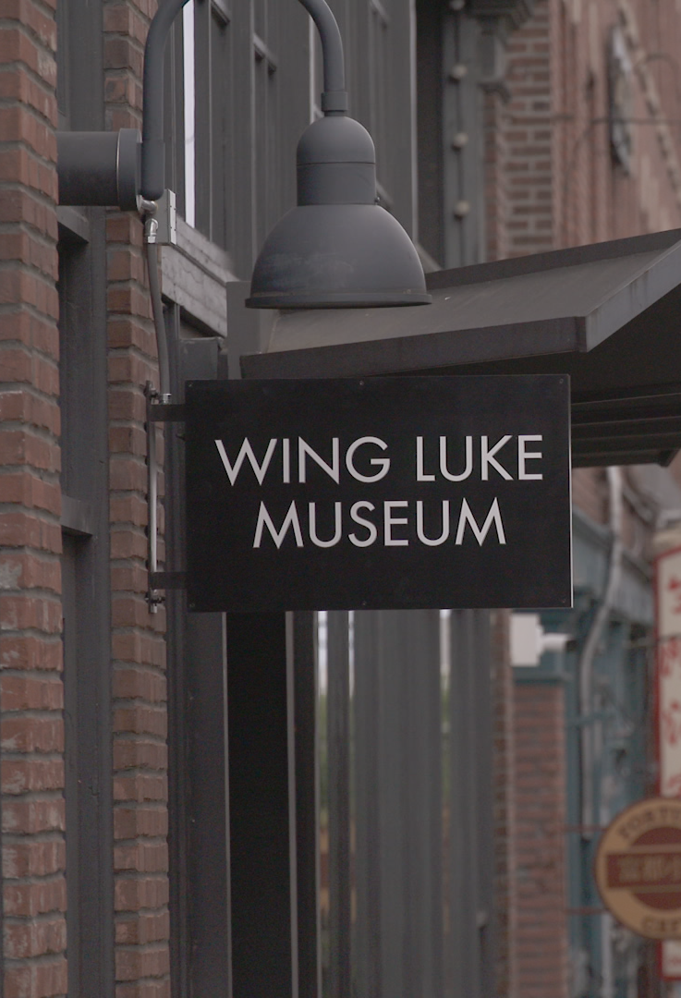
Discover More:
Featuring
Crosby Kemper
Former Director, IMLS
Joël Barraquiel Tan
Executive Director of the Wing Luke Museum
Bettie Luke
Vice President, Ho Nam - Luke Family Association
Lawrence Matsuda, Ph.D.
Poet, Author & Fisherman
Beth Takekawa
Former Exe. Direc. Wing Luke Museum
Gary Locke
21st Governor of Washington State, U.S. Secretary of Commerce, and American Ambassador to China
Exploring the Wing Luke Museum in Seattle
Stories of the Asian Pacific American Experience

Slide 20
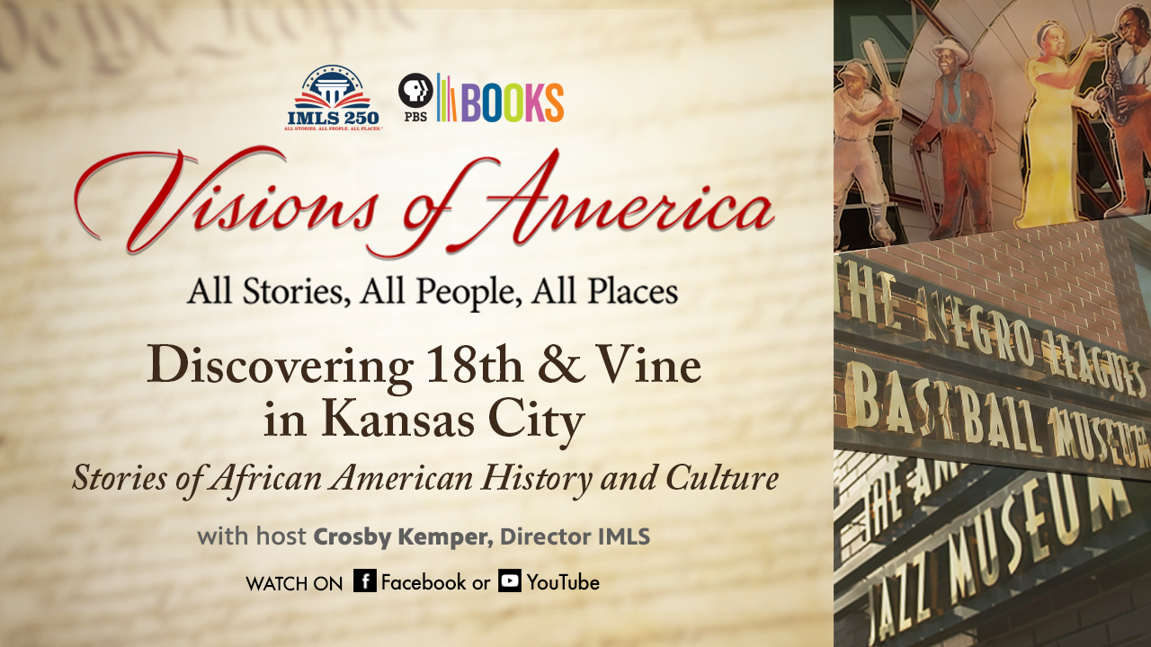
Discover More:
18th & Vine has been the heart and soul of the African American community in Kansas City, bolstering the American dream of freedom and equality. A vibrant center of African American culture, it is the home to important historic sites like the Negro Leagues Baseball Museum (NLBM), the American Jazz Museum and Gates Bar-B-Q highlighting the remarkable role of these Kansas City institutions have played in fostering the community’s comeback.
Discovering 18th & Vine in Kansas City
Stories of African American History and Culture

Slide 21
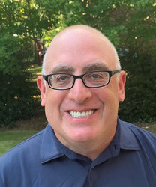
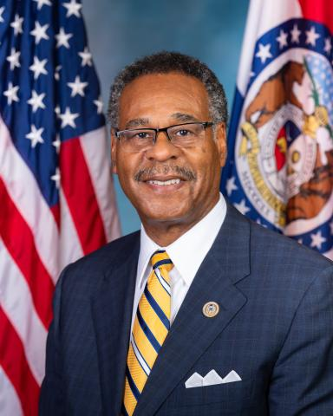
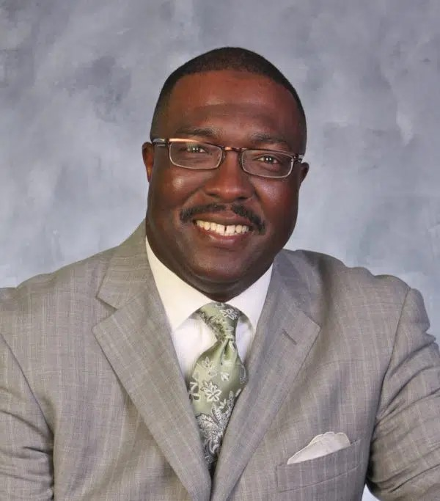
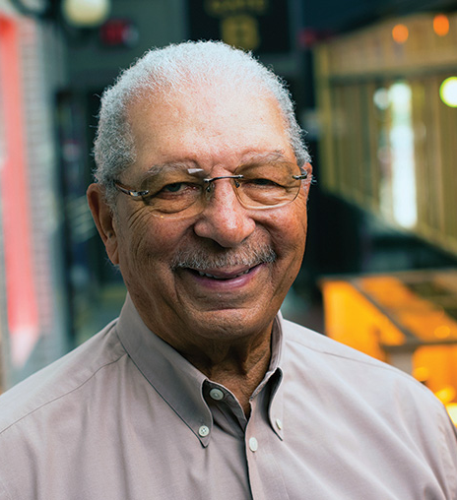
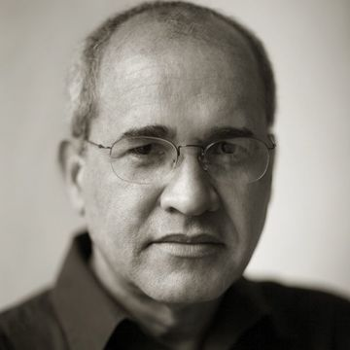
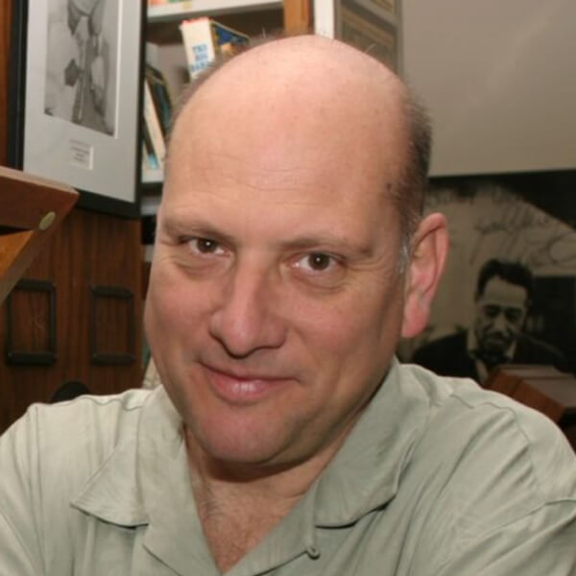
Discover More:
Also
Featured:
Crosby
Kemper
Joe Posnanski
Congressman Emanuel Cleaver
Dr. Arnold Rampersad
Bob Kendrick
Chuck Haddix
Ollie Gates
Muriel Boyd
Former Director, IMLS
Author & Journalist
Congressman, 5th District of Missouri
Biographer, Literacy Critic & Professor Emeritus, Stanford University
President, NLBM
Author & Dir., Marr Sound Archives
Owner & President, Gates Bar-B-Q
Docent & Volunteer Manager, American Jazz Museum
Discovering 18th & Vine in Kansas City
Stories of African American History and Culture

Slide 22
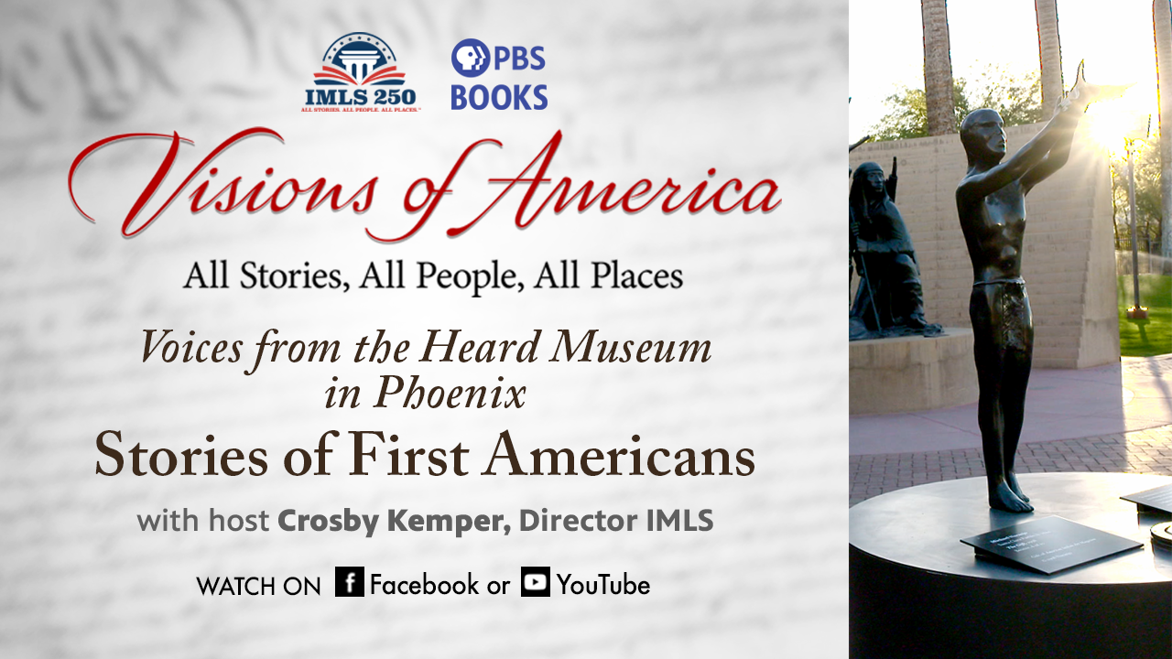
Discover More:
This episode celebrates Native American history, culture, and present-day policy, with a focus on amplifying under heard stories. It explores Indigenous stories of arts, culture, and sports, Native American citizenship and tribal sovereignty, and the changing (and important) place of Native Americans in history.
Voices From the Heard Museum in Phoenix
Stories of First Americans

Slide 23
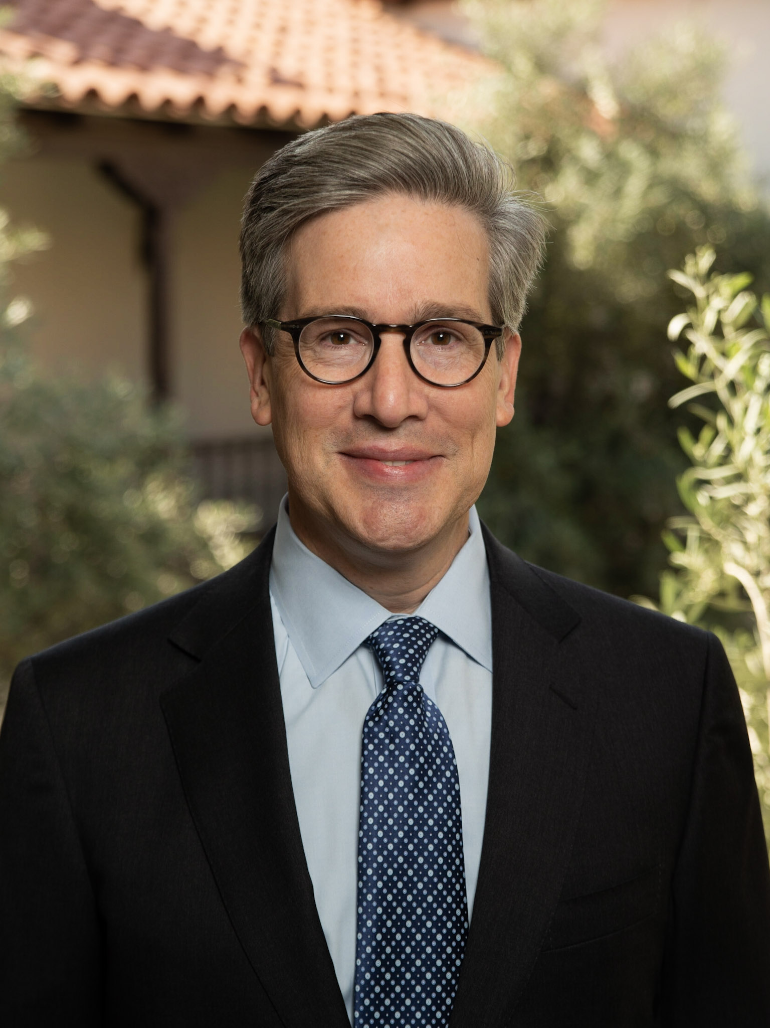
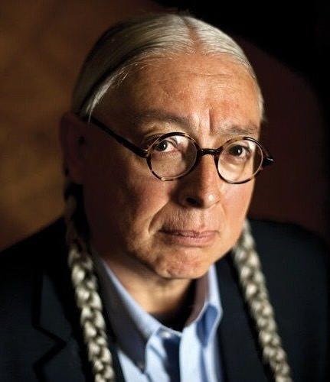
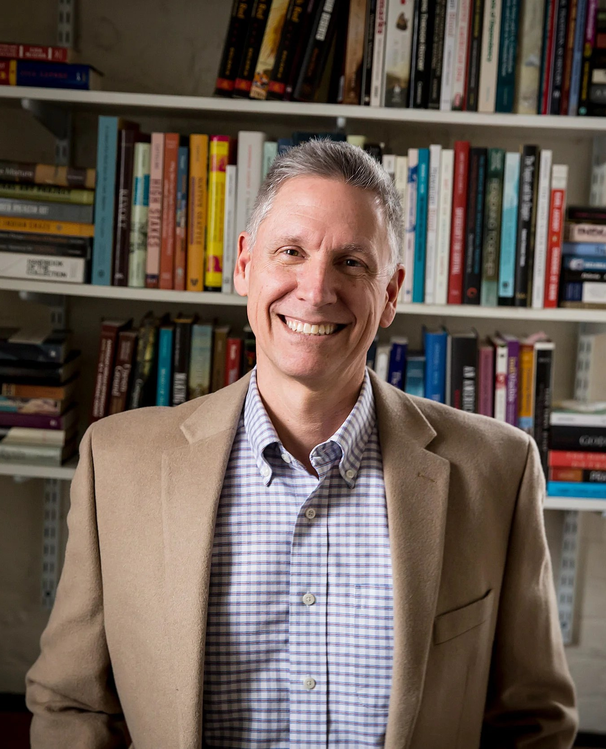
Discover More:
Crosby Kemper
David M. Roche
Walter Echo-Hawk
Philip J. Deloria
Former Director,
IMLS
Director and CEO, The Heard Museum
Past President, Pawnee Nation Business Council (2020-2023),
author, attorney, jurist, and legal scholar
Professor of History, Harvard University,
Author
Voices From the Heard Museum in Phoenix
Stories of First Americans

Slide 24
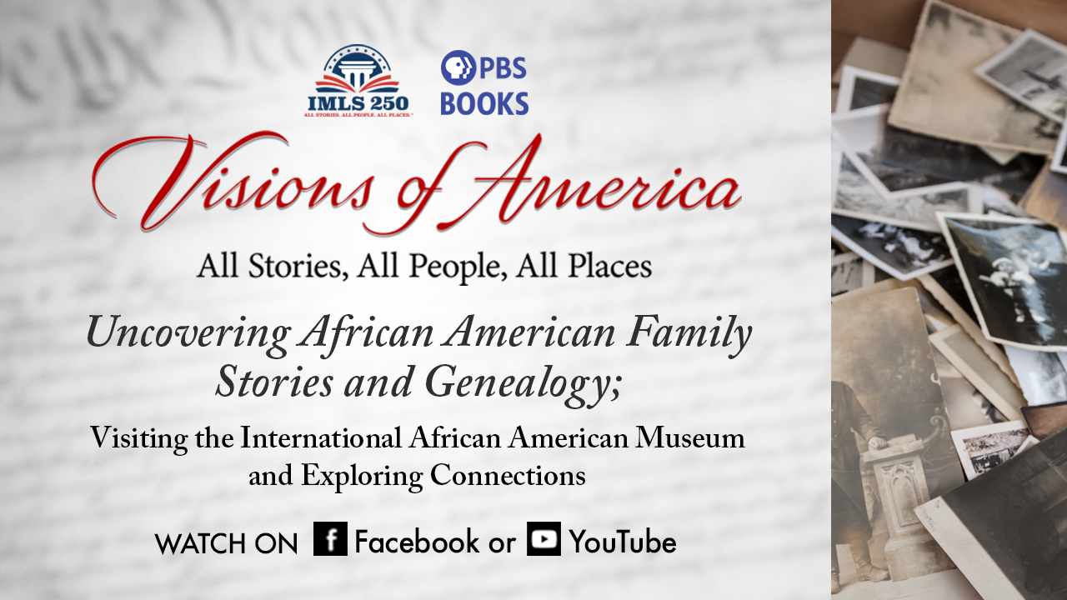
Discover More:
Uncovering African American Stories and Genealogy: Visiting the International African American Museum and Exploring Connections, Celebrates lesser-known stories of African Americans, and explores Charleston-based International African American Museum and the Center for Family History at IAAM. Librarian and scholar, LaVerne Gray, Ph.D. discusses her important work investigating African American connections and collectives that bring people together.
Uncovering African American Family Stories and Genealogy
Visiting the International African American Museum and Exploring Connections

Slide 25
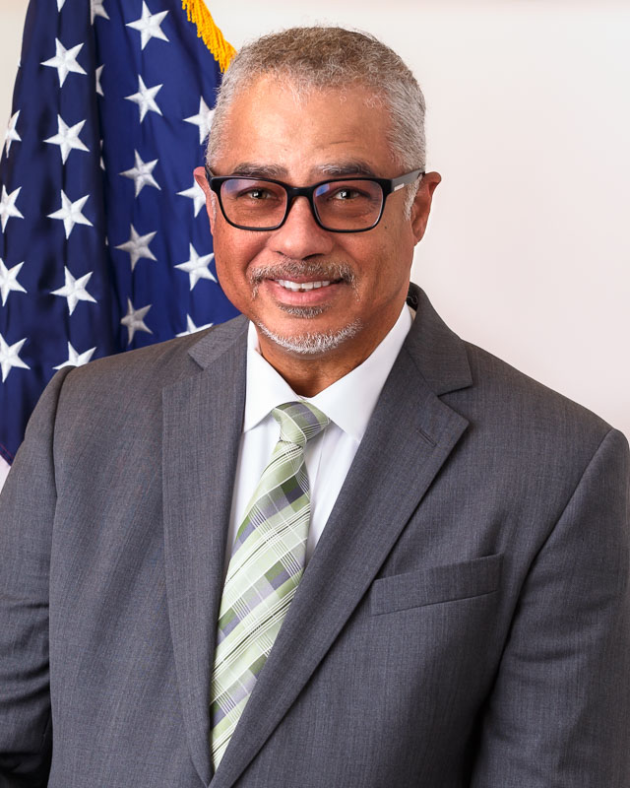
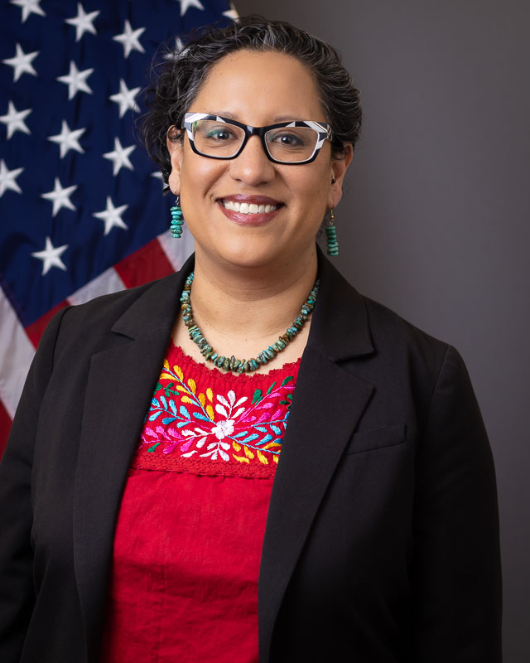
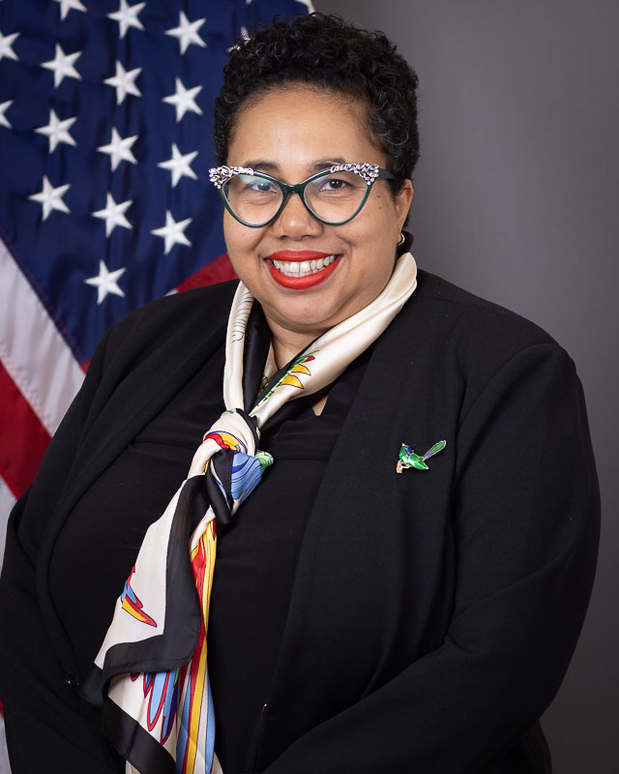
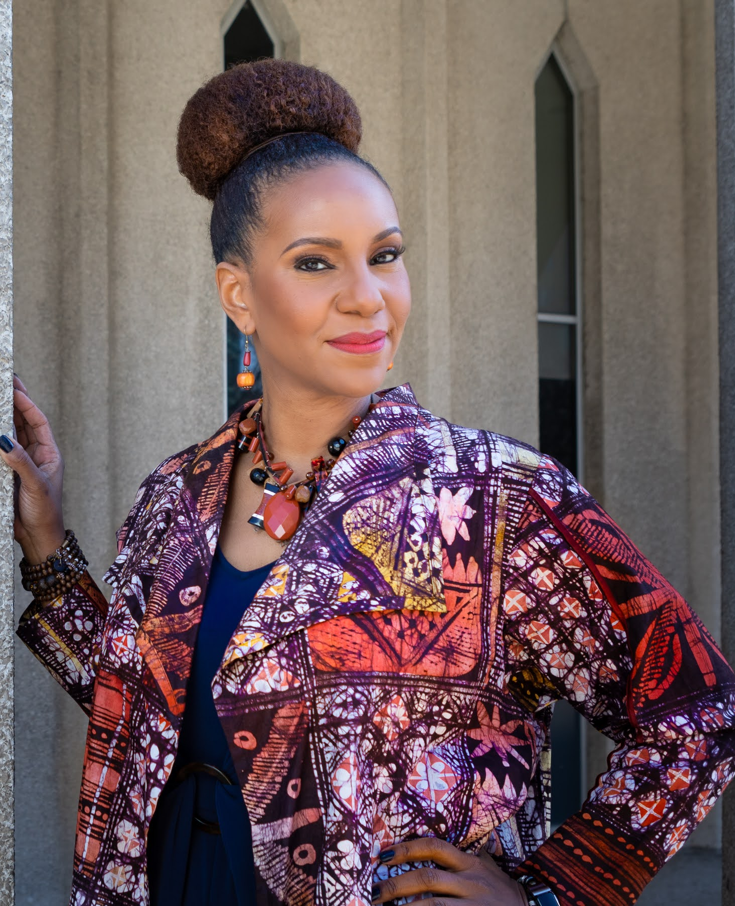
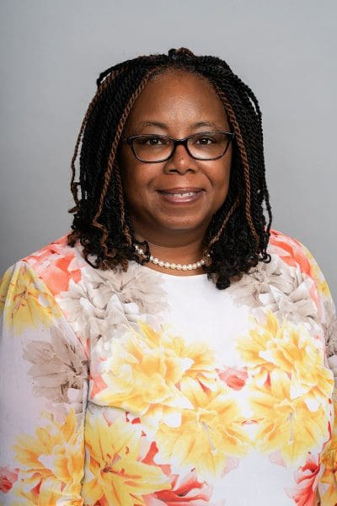
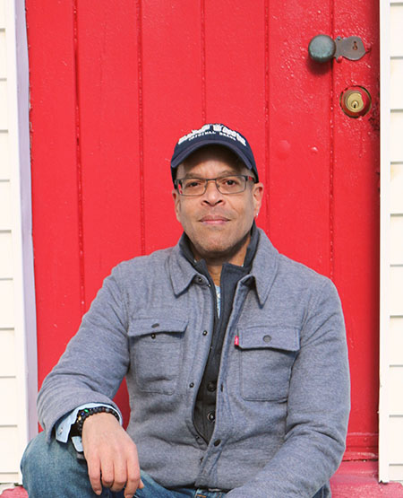
Discover More:
Heather-Marie
Montilla
Anthony D. Smith
Laura Huerta Migus
Cyndee Landrum
Tonya M. Matthews, PhD.
LaVerne Gray, PhD.
Brian Sheffey
National Dir.,
PBS Books
Assoc. Deputy Dir., Discretionary Grants, Office of Library Services, IMLS
Deputy Dir., IMLS
Acting Director, IMLS
President & CEO,
IAAM
Asst. Prof., School of Information Studies, Syracuse University
Dir., the Center for Family History, IAAM
Uncovering African American Family Stories and Genealogy
Visiting the International African American Museum and Exploring Connections

Slide 26
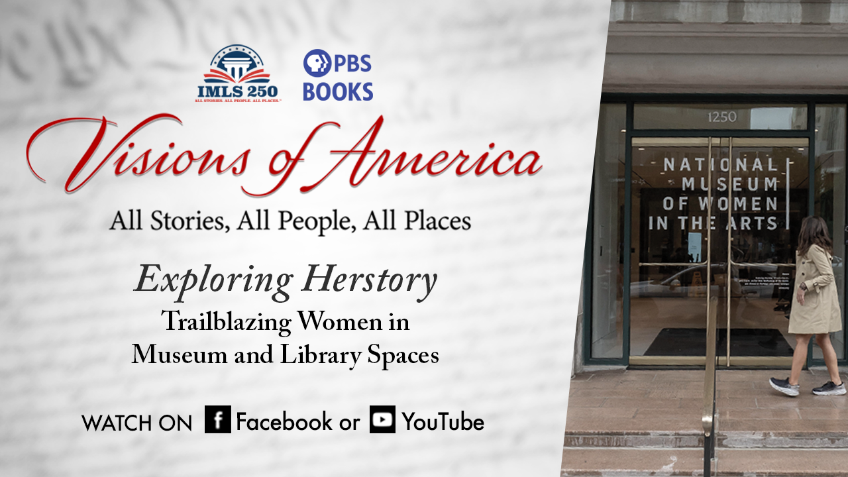
Discover More:
Explore the lesser-known stories of the women, who have been instrumental to contributing to our country’s cultural institutions--libraries, museums and archives. Dr. Carla Hayden, Thelma Golden, Dr. Margaret Walker, and Lucy Somerville Howorth are among the exceptional women discussed.
Exploring Herstory Trailblazing Women in Museum and Library Spaces

Slide 27
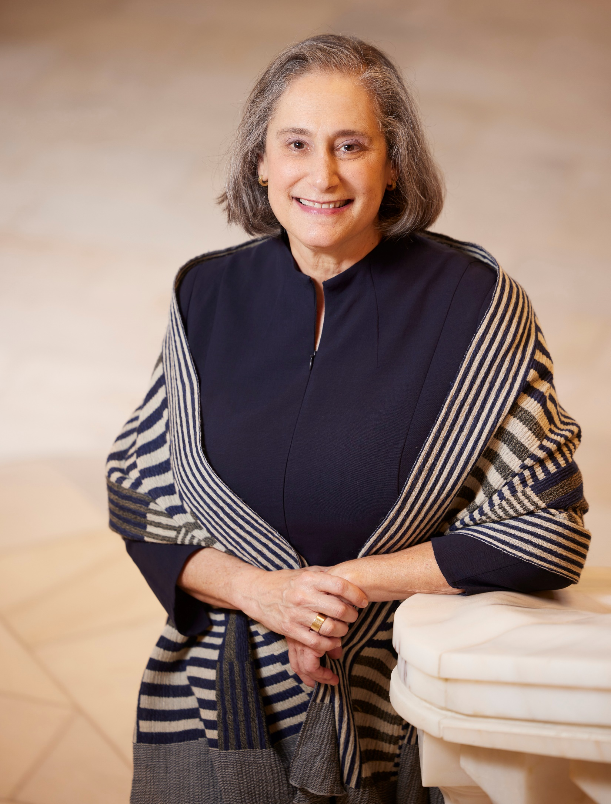
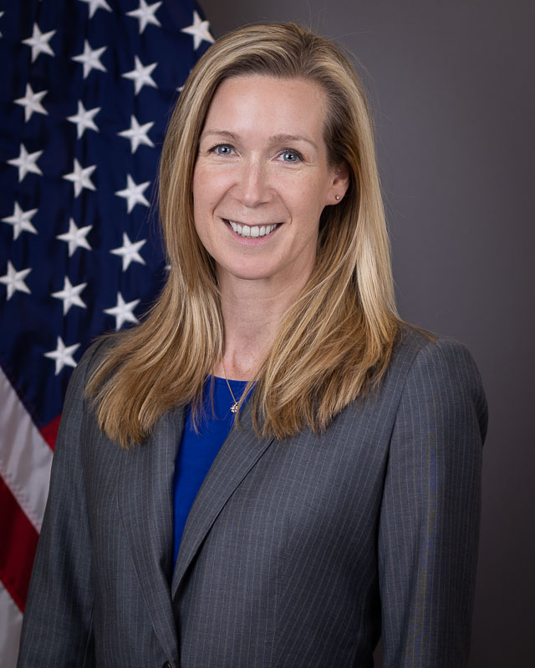
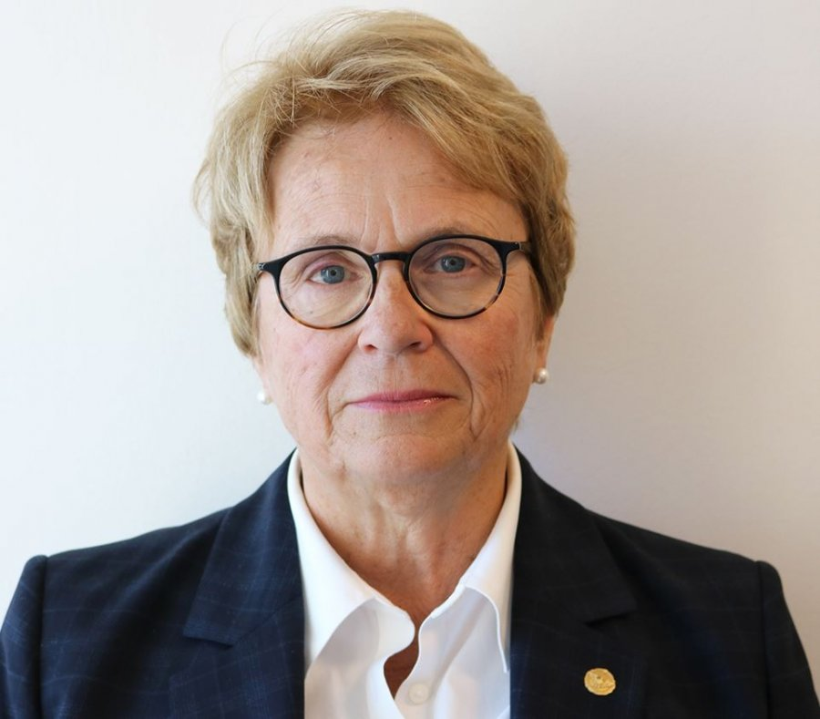
Discover More:
Heather-Marie
Montilla
Susan Fisher Sterling
Teri DeVoe
Anne-Imelda Radice
Laura Huerta Migus
Assoc. Deputy Dir. in the Office of Library Services, IMLS
National Director, PBS Books
Alice West Dir.,
NMWA in Washington, D.C.
Senior Advisor,
Office of the Director, IMLS
Deputy Dir., IMLS
Exploring Herstory Trailblazing Women in Museum and Library Spaces

Slide 28
Discover More:
Additional Information

Slide 29

Discover More:
Have you seen this?

Slide 30
Discover More:
Library and Museum Screeners
WINDOW: 2024​
26 MINUTES​
E-DELIVERY​
OTHER RESOURCES​
DISCUSSION GUIDE​
PROGRAM TIE-INS​
MUSIC LIST​
RELATED VIDEOS​
PRESS RELEASE SAMPLE​
KEY ART​
CURRICULUM (MARCH 2024)
Film Related Resources

Slide 31
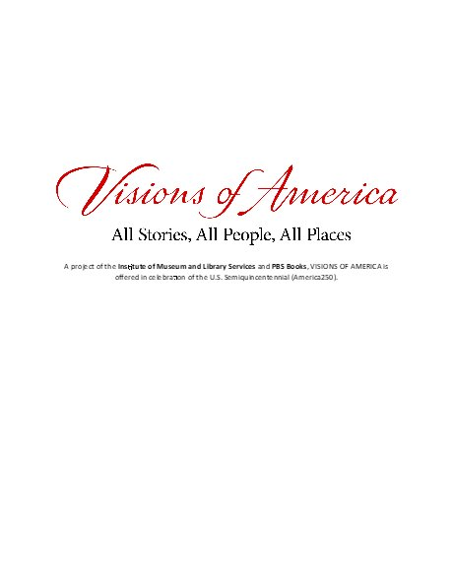
Discover More:
PROJECT SUMMARY​
EPISODE SUMMARY​
BIOS OF CREATORS/LEADERSHIP​
BIOS OF FEATURED GUESTS​
DISCUSSION QUESTIONS​
POSSIBLE PROGRAM TIE IN
Discussion Guide

Slide 32
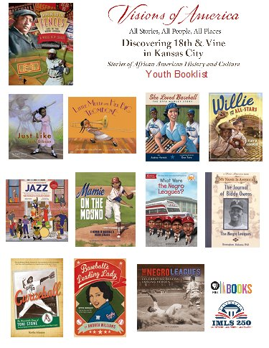

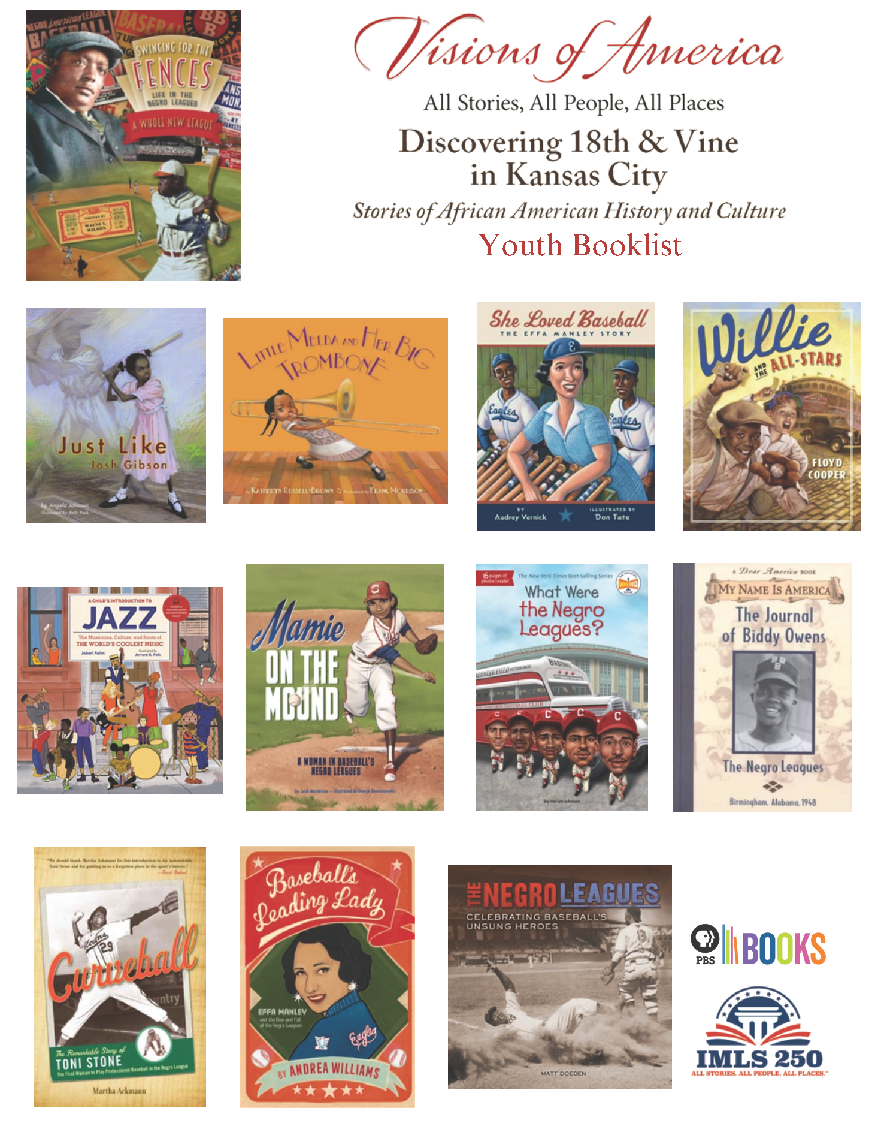
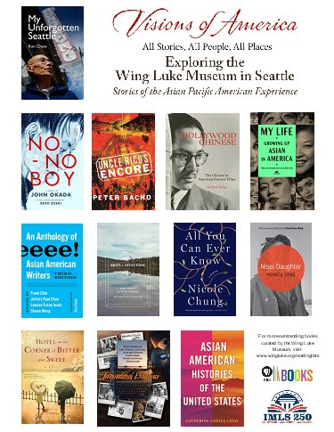



Discover More:
Booklists

Slide 33

Discover More:
Possible uses​
How to access Spotify​
Three music playlist links
Music List

Slide 34


Discover More:
Dropbox Tour

Slide 35
Discover More:
In commemoration of the 250th anniversary of America’s independence, award-winning VISIONS OF AMERICA: All Stories, All People, All Places was created to explore the rich tapestry of our diverse nation with an interest in the stories, people and places that have contributed to the America we live in today. This is an engagement and educational initiative developed by the Institute of Museum and Library Services (IMLS) and PBS BOOKS, which has created multi-media resources (film, discussion guides, book lists, playlist, etc.) to inspire all Americans.
About Visions of America

Slide 36
Discover More:
The Institute of Museum and Library Services is the primary source of federal support for the nation’s libraries and museums. We advance, support, and empower America's museums, libraries, and related organizations through grantmaking, research, and policy development. IMLS envisions a nation where individuals and communities have access to museums and libraries to learn from and be inspired by the trusted information, ideas, and stories they contain about our diverse natural and cultural heritage.
About the Institute of Museum and Library

Slide 37
Discover More:
Started in 2014 by Detroit Public Television, PBS Books is a trusted national brand and a multiplatform initiative connecting diverse audiences to books through PBS stations and programming, daily and original content, book fairs, conferences, live performances, screenings, and other book-related events. The vision of PBS Books is to foster a community of people engaged in unique literary experiences that’s park their curiosity, promote dialogue, and inspire learning. PBS Books aims to provide context for complex issues—both national and local. In early 2019 with the support of the Knight Foundation and the Wyncote Foundation, PBS Books launched a free Library Engagement Program, which currently has more than2,000 library partners. Today, PBS Books produces regular virtual content promoting critical dialogue about current topics and critical issues in communities across the U.S.
About PBS Books

Slide 38
Discover More:
visionsofamerica.org
YouTube.com/pbsbooks
Facebook.com/pbsbooks1
Where to find us

